Slide 1
Stata:
Linear Regression
Hein Stigum
Presentation, data and programs at:
Stata Course - Institutt for helse og samfunn (uio.no)
Notes:
2 h talk:
Part 1: start->influenced
Part 2: recap, influence -> end
Data simulation, analysis, Tables and Figures:
“Gestational Age and Birth weight.do” in "C:\Users\hest\Documents\Courses\Data simulation“
Data: “Gestational Age and Birth weight.dta” in “C:\Users\hest\Documents\Courses\Data”
Tables: “Gestational Age and Birth weight.xlsx” in “C:\Users\hest\Documents\Courses\Common files”

Slide 2
Introduction
DAG

Slide 3
DAG: Gestational age and Birthweight
C2
education
C1
sex
E
gest age
D
birth weight
Birth weight analysis
  Continuous outcome
  Plots of birth weight by gestational age
  Compare means
  Linear regression

Slide 4
Agenda
Purpose
Workflow
Syntax
Testing assumptions
Influence

Slide 5
Background

Slide 6
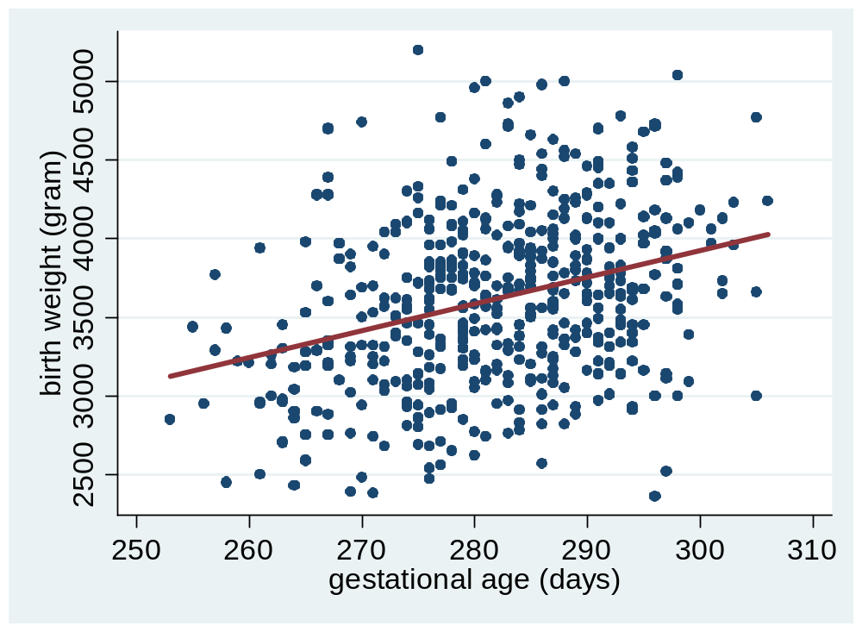
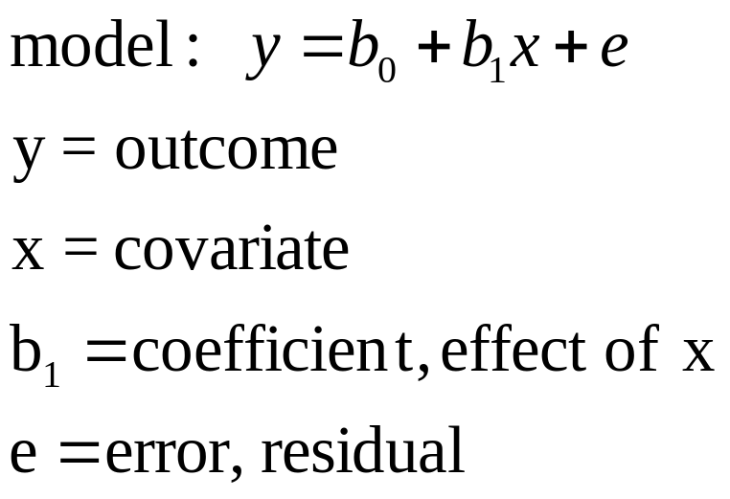
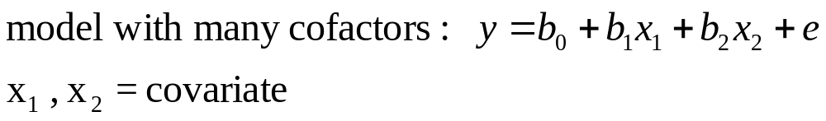
Regression idea
Notes:
X=gest, Y=weigth
straigth line: y=constant +slope times x
beta0=constant or intercept, beta1=reg. coef. Or slope, y=dep. continous, x=..

Slide 7
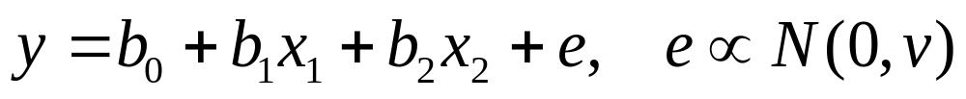
Model, measure and assumptions
Model (standard)
exposure
confounder
Association measure
  b₁ = change in y for one unit increase in x₁
Assumptions for the standard model
  Independent residuals discuss
  No interactions test
  Linear effects test
  Constant residual variance plot/test
can relax
the
assumptions
Influence of outliers plot
Notes:
In GLM b-s and betas are coefficients
In some fields (and in SPSS) b-s are coefs and betas are standardizes coefs

Slide 8
Purpose of regression
Estimation
  Estimate effect of exposure on outcome adjusted for other covariates
  Estimate the effect of smoking on lung cancer
Prediction
  Predict outcome by exposures
  Estimate model (air pollution and distance from roads)
  Predict air pollution in a new dataset using distance from roads
DAGs, bias, precision
Predictive power, model fit, R²
Notes:
Counfounding matter in the first
Fit of the models matters in the last

Slide 9
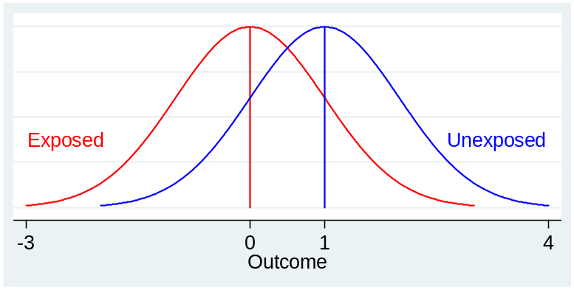
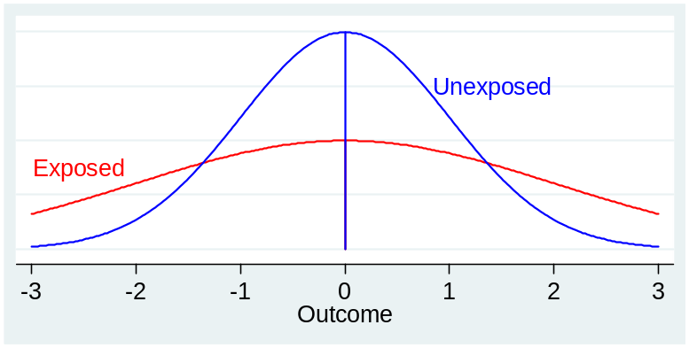
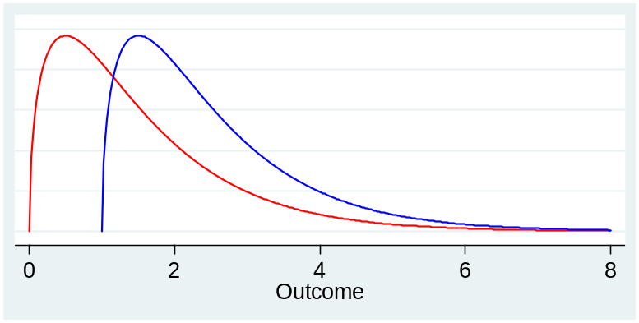
Outcome distributions by exposure
Linear regression
cutoff,
logistic regression
Linear regression
or
Log-transform,
linear regression

Slide 10
Workflow
DAG
C2
education
C1
sex
Scatter- and density plots
Bivariate analysis
Regression
  Model estimation
  Test of assumptions
    Independent residuals
    No interactions
    Linear effects
    Constant error variance
  Influence
    Influence to outliers
E
gest age
D
birth weight
Confounders: education ⇒ adjust
Risk factors: sex ⇒ include
Notes:
Model fitting
Adjust if cofactor is confounder, problems cofacor has missing, cofactor has error, cofactor is in causal path
Test of assumptions
Stata: Estimation remains in memory. Post estimation commands
Normally do assumtions first, then influence.
Note leverage value of outlier

Slide 11
Syntax:
“3 Linear Regression.do”
“Analysis”

Slide 12
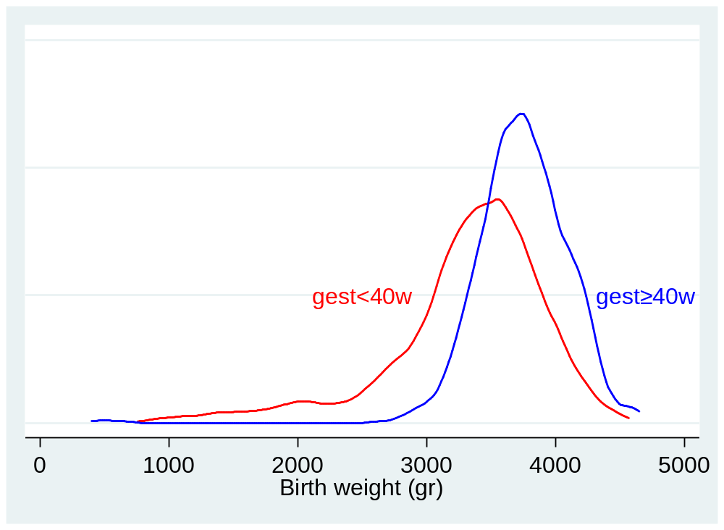
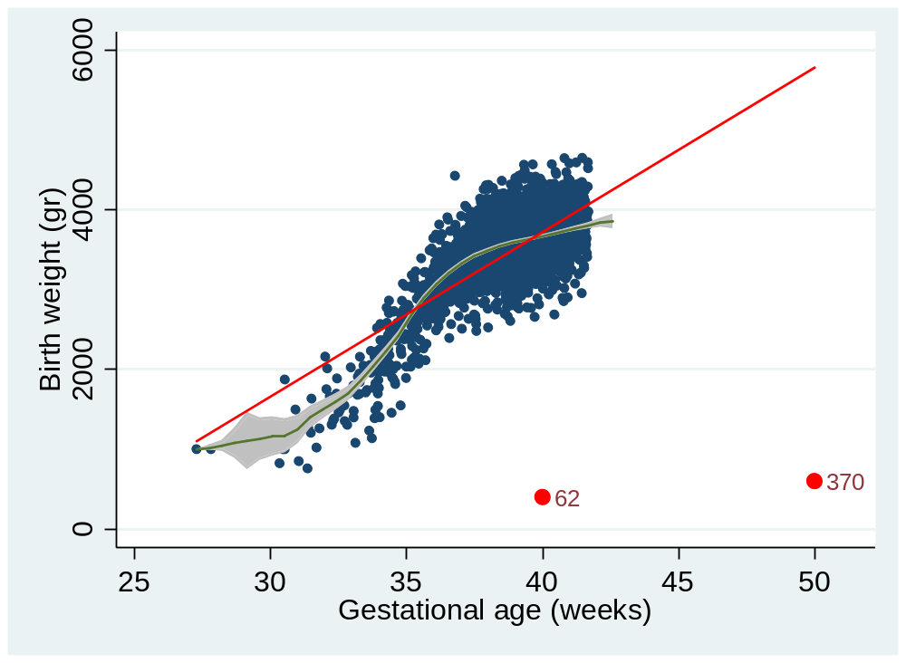
Density and scatter plots
Distribution of birth weight for low/high gestational age
Scatter of birth weight by gestational age
Look for shift in mean,
shift in shape
Look for deviations from linearity
and outliers

Slide 13
Bi-variate
Weight by sex (continuous by binary)
  ttest bw, by(sex) t-test
Weight by education (continuous by categorical-3)
  anova bw, by(educ) one way anova
Weight by gest. age (continuous by continuous)
  regress bw gest regression
  ttest bw, by(gest2) cut in 2, t-test

Slide 14
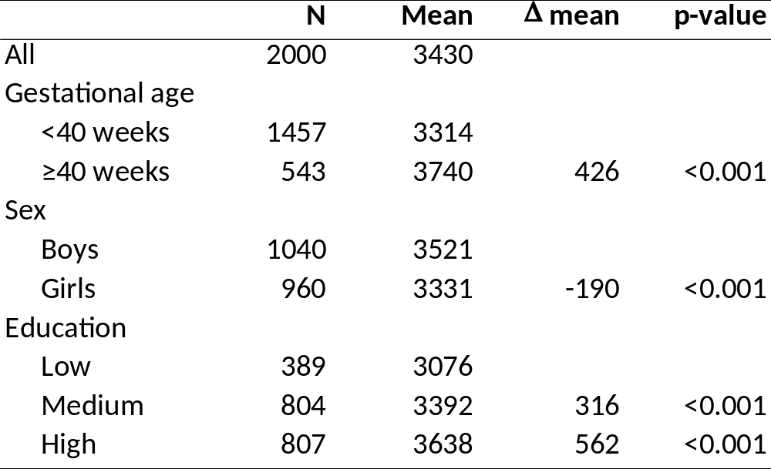
Bi-variate result
Birth weight in gr

Slide 15
Syntax for linear regression
Estimation
  regress y x1 x2 linear regression
  regress y c.age i.sex continuous age, categorical sex
  regress y c.age##i.sex main+interaction
Compare models
  estimates store m1 save model
  estimates table m1 m2 compare coefficients
  estimates stats m1 m2 compare model fit
Post estimation
  predict res, residuals predict residuals in new “res”
Notes:
Many post estimation commands, estimation alive until new estimation command
i.sex idicator type contrast

Slide 16
Factor (categorical) variables
Variable
  educ = 1, 2, 3 for Low, Medium and High education
Built in
  i.educ use educ=1 as base (reference)
  ib3.educ use educ=3 as base (reference)
  help fvvarlist help for factor variables
Manual “dummies”*
  educ=1 as base, make dummies for 2 and 3
  generate Medium =(educ==2) if educ<.
  generate High =(educ==3) if educ<.
*margins and contrast require i.var notation
Notes:
help fvvarlist
ib3.educ use value 3 as base (reference)
ib(3).educ use 3. category as base
ib(freq).educ use most frequent as base

Slide 17
Continuous variables
Variable
  Gestational age ranging from 28 to 42 weeks (mode=40)
Built in
  c.gest default except for interactions
Advice
  Do not categorize continuous variables in a final analysis!
    Loss of power
    Increased measurement error
    Spurious interaction
  Whether exposure, confounder (or outcome)
  Need methods for non-linear effects (polynomials, splines)
(Royston, Altman et al. 2006)

Slide 18
Syntax
“Regression analysis”

Slide 19
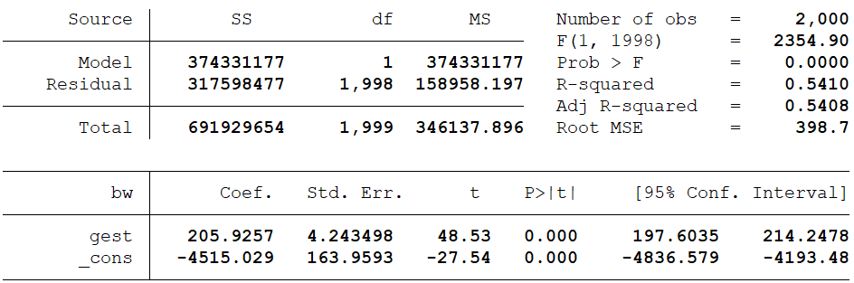
Model 1: outcome+exposure
regress bw gest crude model
estimates store m1 store model results

Slide 20
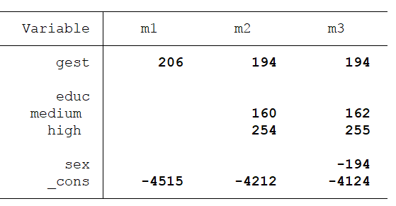
Model 2 and 3: Add covariates
regress bw gest i.educ sex add covariates
estimates table m1 m2 m3 compare coefs
Estimate association:
m1 is biased, m2=m3
m3 more precise?
m2: se(gest)=4.3
m3: se(gest)=4.2
Conclusion:
m1 is biased, m2 and m3 are unbiased, but m3 is more precise
(Robinson and Jewell 1991, (VanderWeele 2008))
Notes:
Notice that the education estimates are totally off, due to the blocking of the indirect effect throug gest

Slide 21
Influence
Measures of influence
would normally handle assumptions first
Notes:
1) The wild outlier may ruin our test of assumptions
2) Easier to understand influence when effects are linear and without interaction

Slide 22
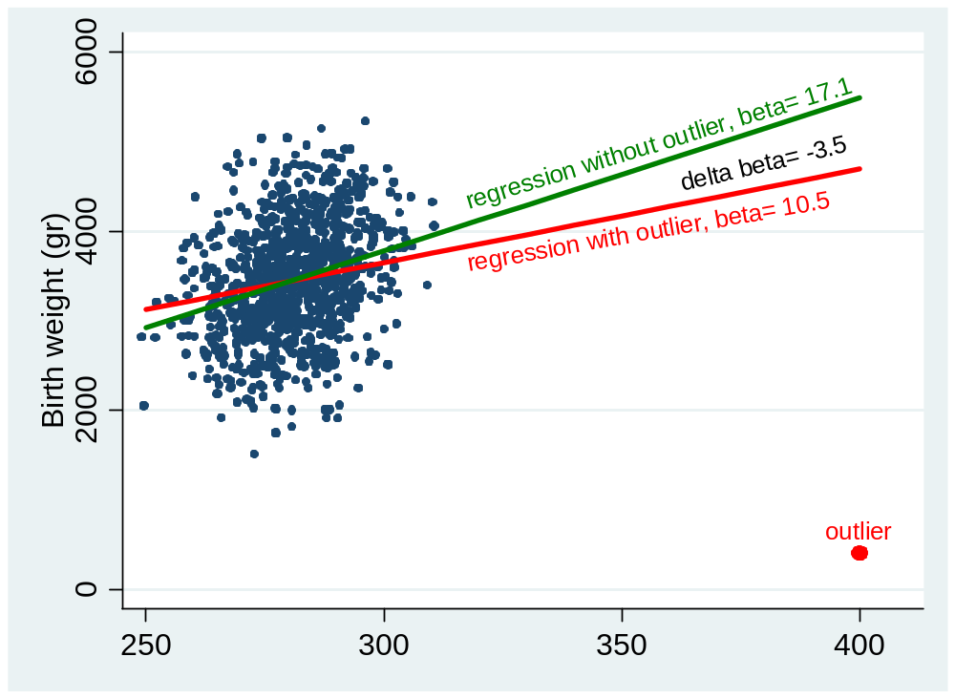
Influence idea (different data)
delta beta*se=-6.8
Notes:
Have taken N down to 1000 and moved outlier out to gest=400
Beta changes from 10 to 17 when removing influential outlier
Est change=Delta beta*se(gest)=-3.5*2.1=-6.8

Slide 23
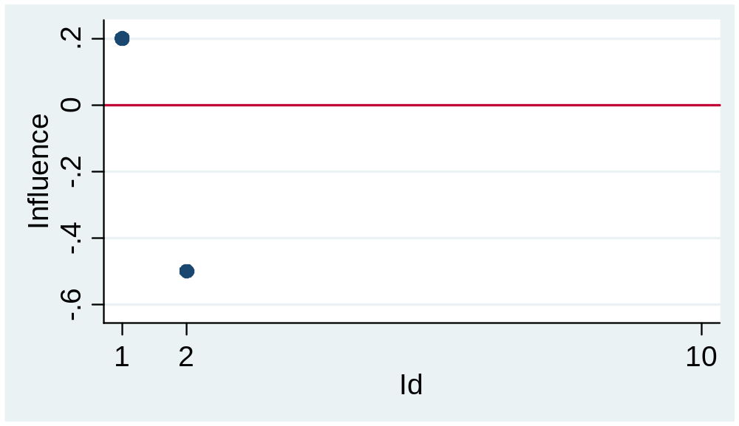
Measures of influence
Remove obs 1, see change
remove obs 2, see change
One delta-beta
per observation
(per covariate,
the exposure)
Measure change in:
  Coefficients (beta)
    Delta beta (scaled by se(coeff))

Slide 24
Syntax:
“Influence of outliers”

Slide 25
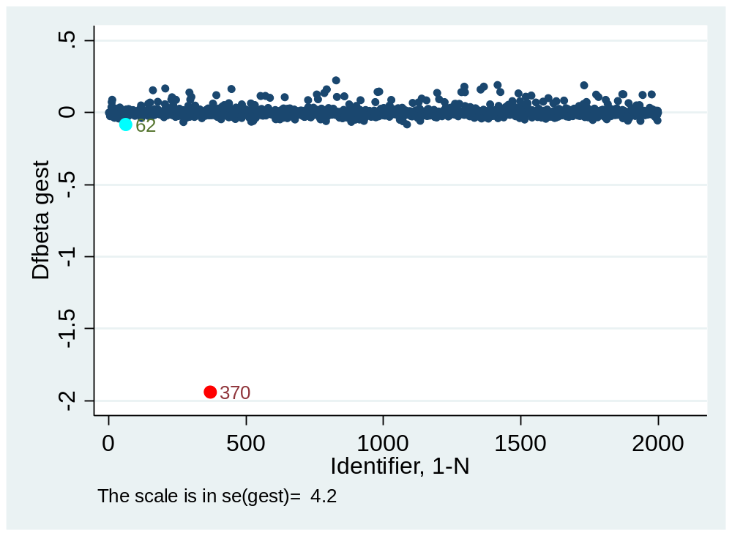
Delta-beta for gestational age
dfbeta(gest) create delta-beta
scatter _dfbeta_1 id plot vs id-variable
OBS
variable specific
If obs nr 370 is removed, beta will change
2 se’s=
2*4.2≈8 gr

Slide 26
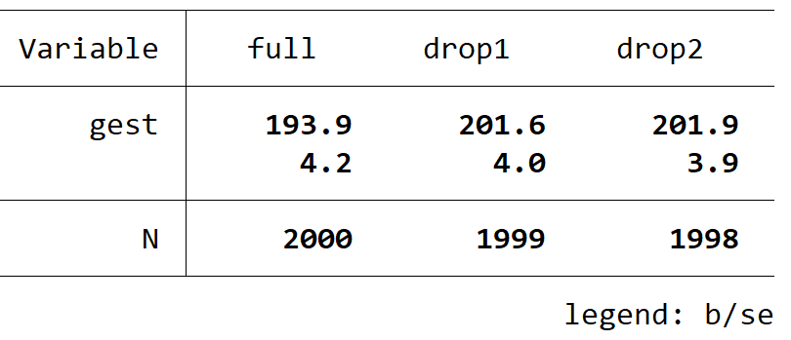
Removing outliers
regress bw gest i.educ sex if id!=370
est store drop1
regress bw gest i.educ sex if id!=370 & id!=62
est store drop2
est table full drop1 drop2, b(%8.0f)
Conclusion:
Outlier 370 had a large effect
Outlier 62 had a small effect on the “se”
Notes:
Est change=delta-beta*se=2*6=12 gr

Slide 27
Assumptions

Slide 28
Assumptions of the standard model
  Independent residuals
  No interactions
  Linear effects
  Constant residual variance
discuss
test in model
add splines
plot, test
Dependent residuals?
When will the
birth weight of one child
depend on
the birth weight of another?
Siblings, twins

Slide 29
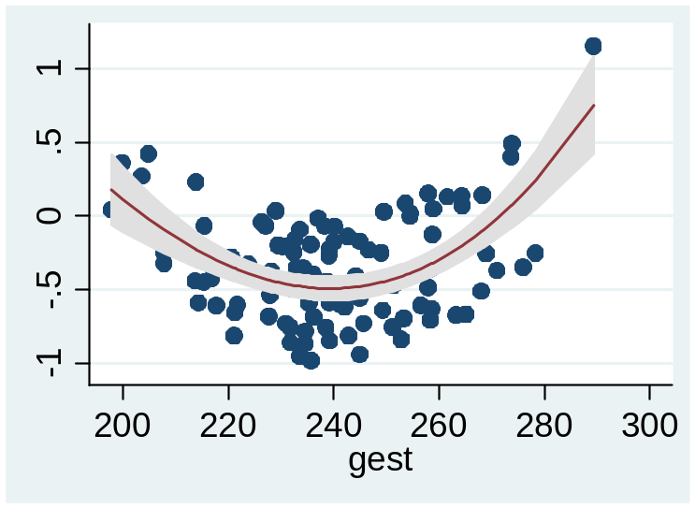
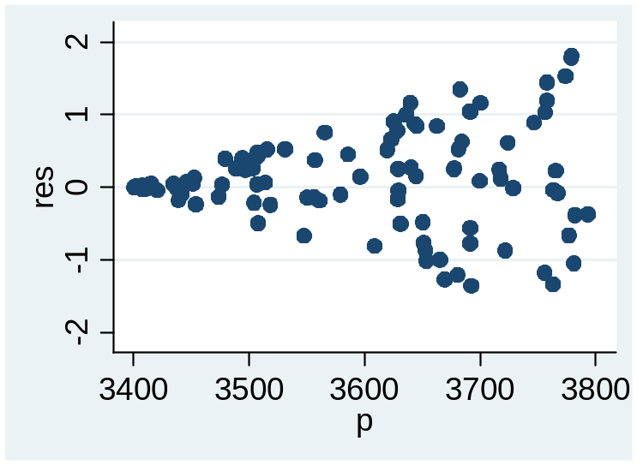
If violations of assumptions
Dependent residuals
  ,vce(cluster var) or mixed models
Interactions
  Add interaction term
Non linear effects
  Add polynomial or spline
Non-constant variance
  Use robust variance estimation
  regress y x, robust
Notes:
Robust variance estimation with cluster variable: regress y x1 x2, vce(cluster Mother_id) or vce(cluster village)
Linear mixed models: xtmixed
Robust variance: regress y x1 x2, robust

Slide 30
Interaction only linear effects

Slide 31
Interaction
Interaction: combined effect of two variables
Example
  y= b₀+b₁x+b₂sex effect of x does not depend on sex
  y= b₀+b₁x+b₂sex+ b₃x∙sex effect of x depends on sex (interaction)
Test
  Interaction if b₃≠0
Scale
  Linear models additive
  Logistic, Poisson, Cox multiplicative
  Interaction is scale dependent
    No interaction on the additive scale implies interaction on other scales

Slide 32
Syntax
“Interaction”

Slide 33
Interaction (only linear effects)
Add interaction terms
Show results
regress bw c.gest##i.sex i.educ main + gest-sex interaction
margins, dydx(gest) at(sex=0) effect of gest for boys
margins, dydx(gest) at(sex=1) effect of gest for girls

Slide 34
Non-linear effects

Slide 35
Smoothers in regressions
Polynomials
  x, x^{2,} x³
Fractional polynomials (2 of 8)
  x⁻², x⁻¹, x^{-0.5} log(x), x^{0.5} x, x², x³
y
x
Splines
  cubic
  linear
knots
only plots
y
estimates
c₁
c₂
x
Polynomials: global
Splines: local
(Govindarajulu, Malloy et al. 2009, Binder, Sauerbrei et al. 2013, Kahan, Rushton et al. 2016)
Notes:
2 of 6 =28 models

Slide 36
Syntax
“Linear effect”
Using polynomials

Slide 37
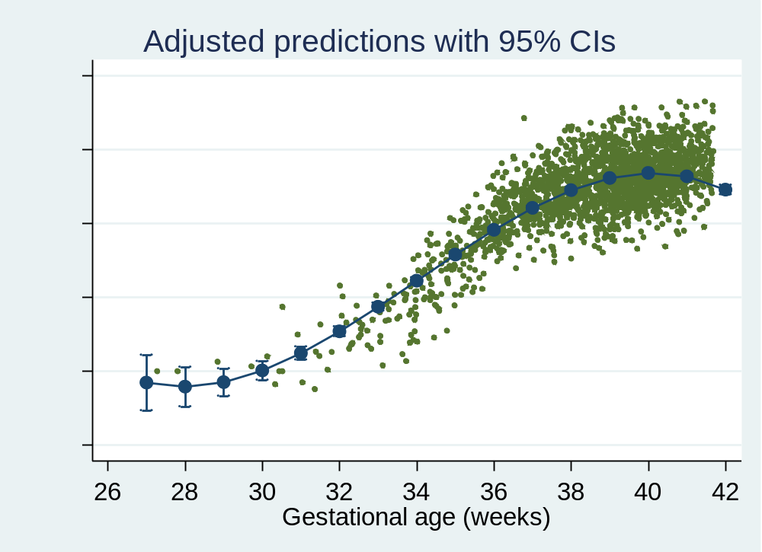
3.order polynomial
3.order polynomial
Plot
regress bw c.gest##c.gest##c.gest i.educ sex regression with polynomial
margins, at(gest=(27(1)42) sex=0.5 educ=2) predicted bw by gest
marginsplot plot
Conclusion:
Good fit.
Clear deviations
from linearity.
Notes:
Package:
findit postrcspline
ssc hot author(Buis) Statistical Software Components

Slide 38
Summing up: non-linear effects
Capture non-linearities in continuous variable
  Categorize, lose precision
  Polynomials or splines
Continuous exposure
  Replace by 3.order polynomial: good fit
Continuous confounder
  Keep linear (unless non-linear in both exposure and outcome effect)

Slide 39
Syntax
“Linear effect”
Using Splines

Slide 40
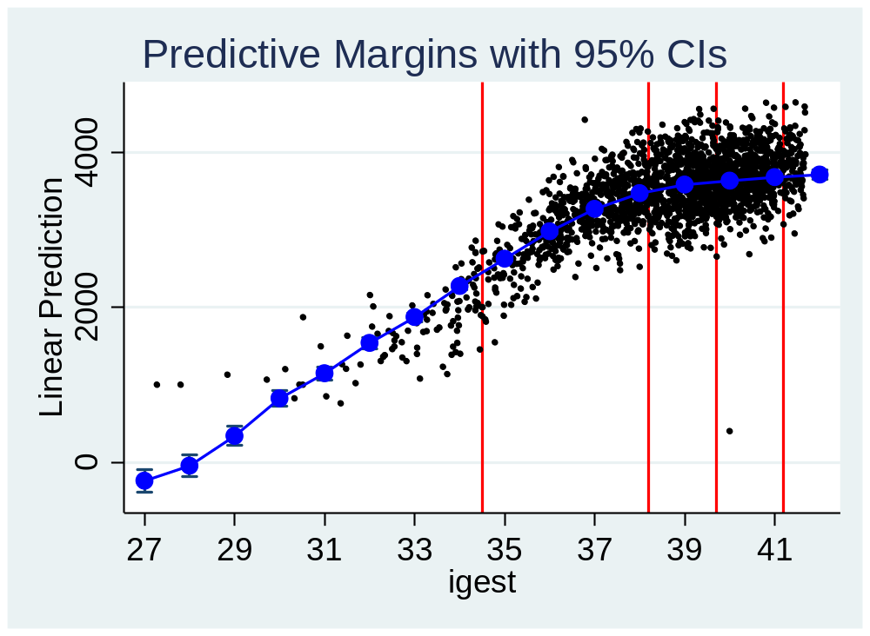
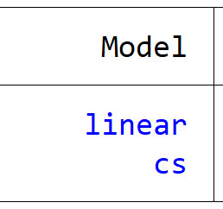
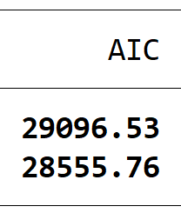
Cubic spline
Cubic spline
Plot
Test
mkspline c=gest, cubic nknots(4) make spline with 4 knots (c1,c2,c3)
regress bw c1 c2 c3 i.educ sex regression with spline
est store cs store estimates as cs
gen igest=round(gest) integer values of gest
margins, over(igest) predicted bw by gest
marginsplot plot
est stats linear cs AIC
better fit
Notes:
Package:
findit postrcspline
ssc hot author(Buis) Statistical Software Components

Slide 41
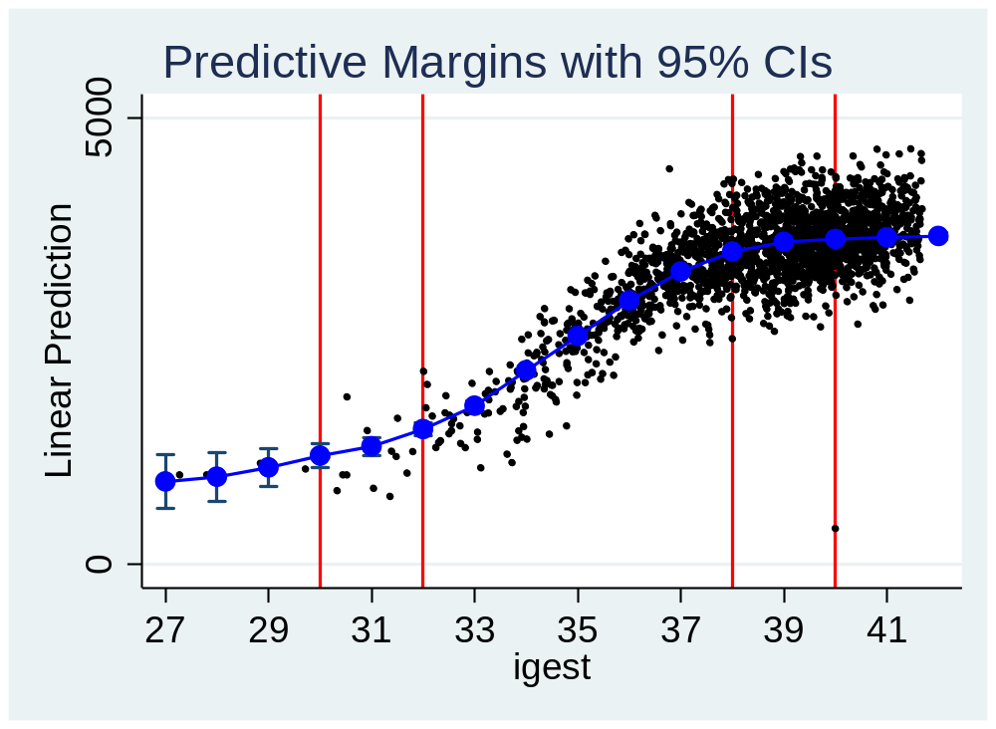
Cubic spline with given knots
Cubic spline
mkspline c=gest, cubic knots(30 32 38 40)
regress bw c1 c2 c3 i.educ sex regression with spline
Better fit
at low gest
Notes:
Better AIC in this model

Slide 42
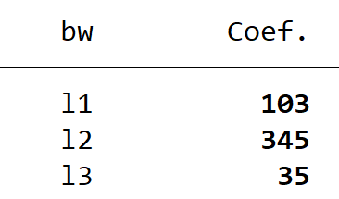
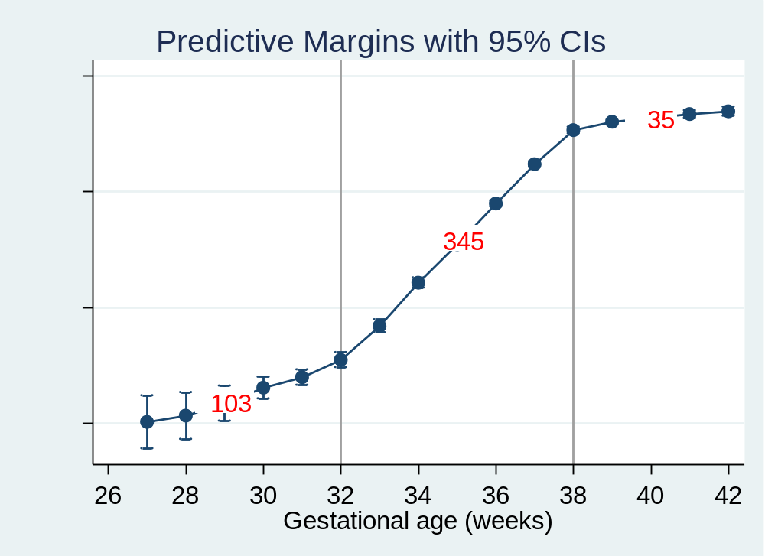
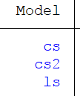
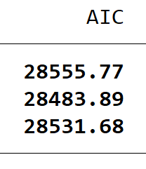
Linear spline
Linear spline
Plot (as before)
Test (as before)
mkspline l1 32 l2 38 l3=gest linear spline with knots at 32 and 38
regress bw l1 l2 l3 i.educ sex regression with spline
est store ls store estimates as ls
best fit
2.best fit
Different from categorical gest!

Slide 43
Summing up: non-linear effects
Capture non-linearities in continuous variable
  Categorize, lose precision
  Fractional polynomials or splines are better
Continuous exposure
  Replace by cubic spline: good fit, only plot
  Replace by linear spline: good fit, estimates
Continuous confounder
  Keep linear (unless non-linear in both exposure and outcome effect)

Slide 44
Constant residual variance

Slide 45
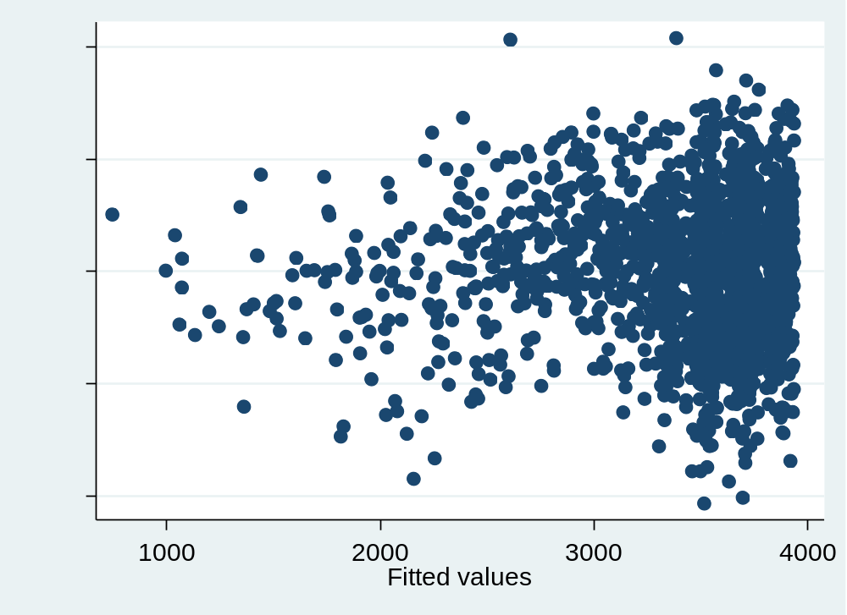
Test constant residual variance
Constant variance:
Plot
Test
plot residual versus predicted (fitted)
rvfplot
estat hettest
or,
compare se-s
with and without “robust”
some heteroscedasticity

Slide 46
Syntax :
“Constant residual variance”

Slide 47
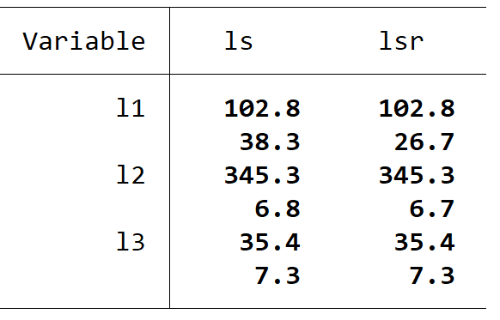
Final model
Linear spline model with robust variance estimation:
regress bw l1 l2 l3 i.educ sex, robust
est store lsr
estimates
se
estimates
se
estimates
se
Prefer the robust model
Conclusion:
At 27-32 weeks the birth weight increases with 104 gr per week
At 32-38 weeks the birth weight increases with 345 gr per week
At 38-42 weeks the birth weight increases with 35 gr per week
Notes:
The correct model for estimating the effect of education on birth weight is:
regress bw i.educ sex , the model should not contain gest
The estimates are:
Medium= 145 gr
High= 322 gr, quite different from the estimates from the final model that contains gest!!!

Slide 48
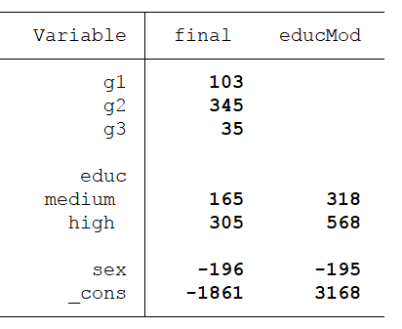
Correct model for effect of education
Interpret other covariate effects from the model?
Tables
DAGs
final
educMod
Exposure:
gest
educ
educ
educ
gest
bw
gest
bw
educ
confounder
adjust
gest
mediator
not adjust
Conclusion:
Effect of education is misleading in the final model.
Need a separate model for each covariate
(Westreich and Greenland 2013)
Notes:
Weeks of gest

Slide 49
Help
Linear regression
  help regress
    syntax and options
  help regress postestimation
    dfbeta
    estat hettest
    rvfplot
    predict
    margins
  help factor variables
    factor variables and interactions
Notes:
List of regression commands: short list =35 types

Slide 50
Summing up 1: Model fitting
Build model
  regress bw gest crude model
  est store m1 store
  regress bw gest i.educ sex full model
  est store m2
  est table m1 m2 compare coefficients

Slide 51
Summing up 2: Assumptions
Independent residuals discuss
No interaction
  regress bw3 c.gest##i.sex i.educ test interaction
  margins, dydx(gest) at(sex=0) gest for boys
Linear effects
  mkspline g1 38 g2 linear spline
  regress bw g1 g2 i.sex i.educ estimate splines
Constant residual variance
  rvfplot residual versus fitted
  regress …, robust robust variance

Slide 52
Summing up 3: Influence of outliers
Influence
  dfbeta(gest) delta-beta
  scatter _dfbeta_1 id plot versus id

Slide 53
References
Binder H, Sauerbrei W, Royston P. 2013. Comparison between splines and fractional polynomials for multivariable model building with continuous covariates: A simulation study with continuous response. Stat Med 32:2262-2277.
Daniel R, Zhang J, Farewell D. 2020. Making apples from oranges: Comparing noncollapsible effect estimators and their standard errors after adjustment for different covariate sets. Biom J.
Govindarajulu US, Malloy EJ, Ganguli B, Spiegelman D, Eisen EA. 2009. The comparison of alternative smoothing methods for fitting non-linear exposure-response relationships with cox models in a simulation study. Int J Biostat 5.
Kahan BC, Rushton H, Morris TP, Daniel RM. 2016. A comparison of methods to adjust for continuous covariates in the analysis of randomised trials. BMC medical research methodology 16.
Robinson LD, Jewell NP. 1991. Some surprising results about covariate adjustment in logistic-regression models. Int Stat Rev 59:227-240.
Royston P, Altman DG, Sauerbrei W. 2006. Dichotomizing continuous predictors in multiple regression: A bad idea. Stat Med 25:127-141.
VanderWeele TJ, Hernan MA, Robins JM. 2008. Causal directed acyclic graphs and the direction of unmeasured confounding bias. Epidemiology 19:720-728.
Westreich D, Greenland S. 2013. The table 2 fallacy: Presenting and interpreting confounder and modifier coefficients. AJE 177:292-298.
Xing C, Xing GA. 2010. Adjusting for covariates in logistic regression models. Genet Epidemiol 34:937-937.

Slide 54
Extra material

Slide 55
Test deviance from linearity
regress y x₁ x₂ linear term
  estimates store lin
regress y f(x₁) x₂ smoother term
  estimates store smo f(x₁)=poly or spline
  estimates table lin smo LR-test or AIC

Slide 56
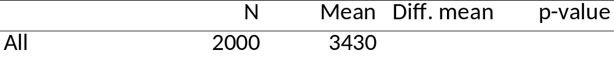
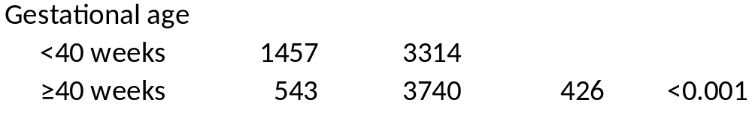
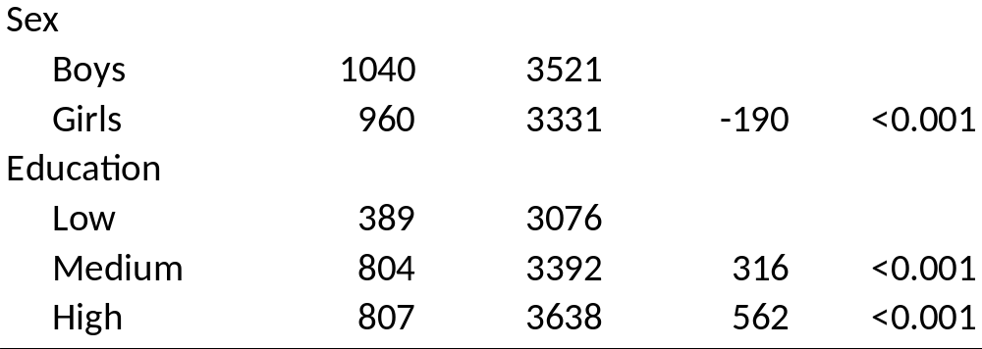
Table 1
Outcome: Birth weight
Exposure: Gestational age
Covariates:

Slide 57
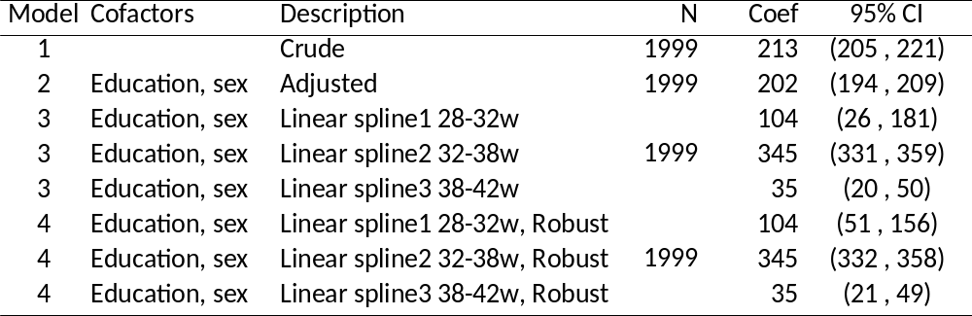
Table 2
Do not show coefficients from cofactors,
they may be misleading
(Westreich and Greenland 2013)

