Slide 1
6 Macro, Matrix and
Loop, Examples
3h
Hein Stigum
Presentation, data and programs at:
Stata Course - Institutt for helse og samfunn (uio.no)
Apr-23
H.S.
1

Slide 2
Agenda
Two syntax files
  Examples, Commands
“Automated” analyses
  Returned results
  Macro
  Matrix
  Loops
  Data frames

Slide 3
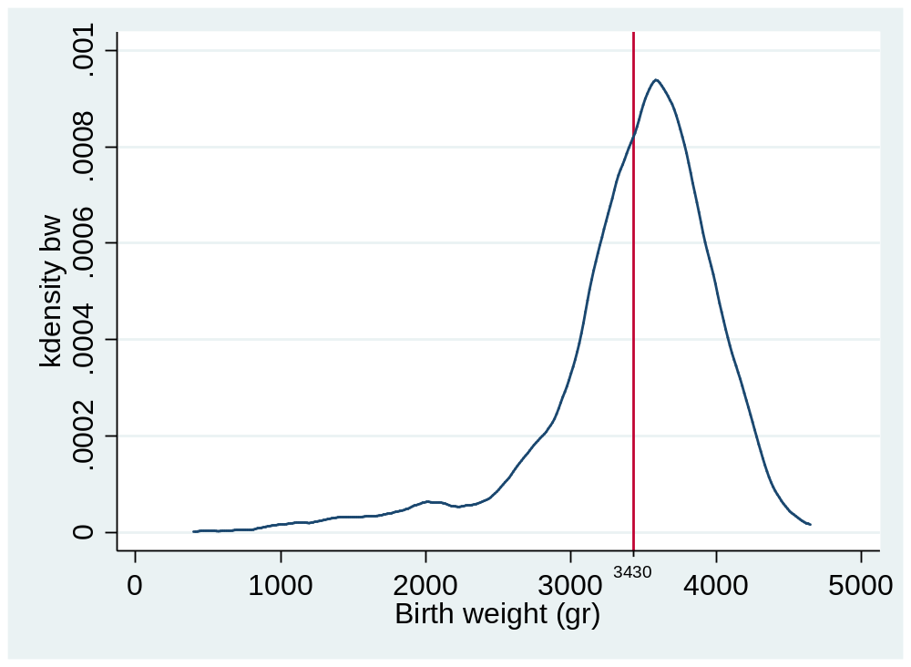
Returned results
Go to Syntax: Examples

Slide 4
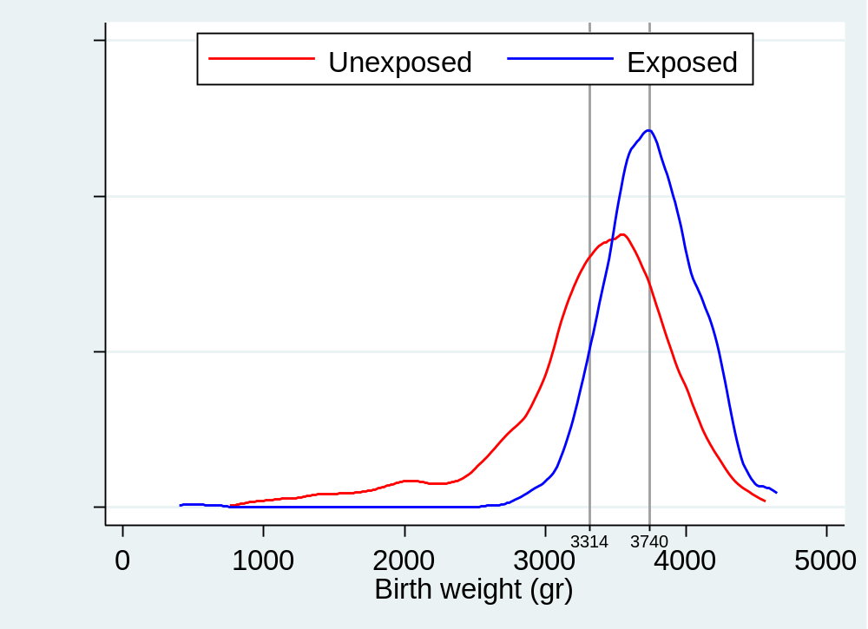
Macros
Go to Syntax: Commands

Slide 5
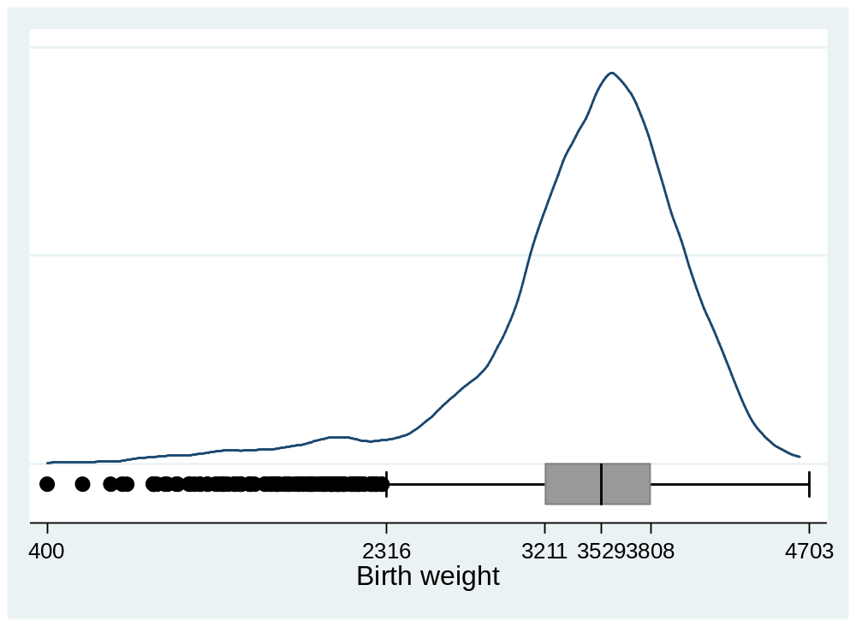
Macros
Go to Syntax: Commands

Slide 6
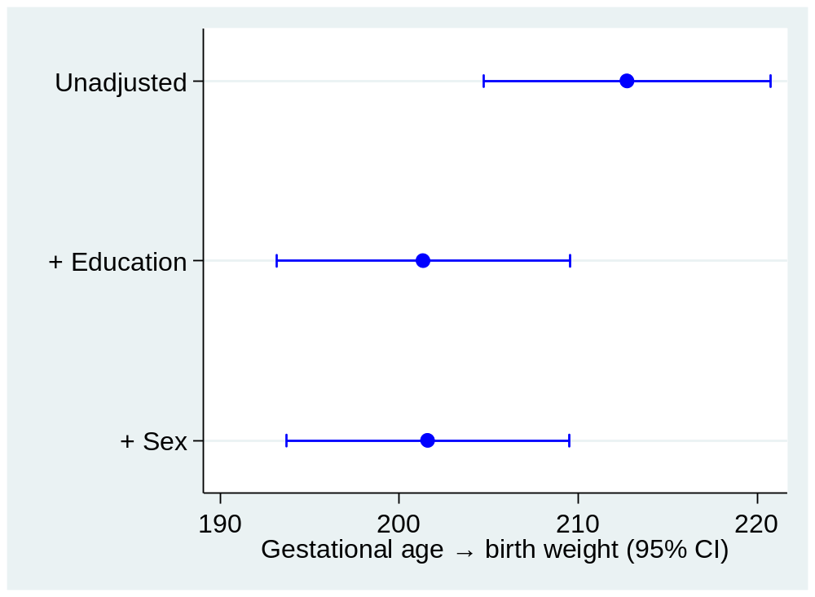
Matrix
Go to Syntax: Examples

Slide 7
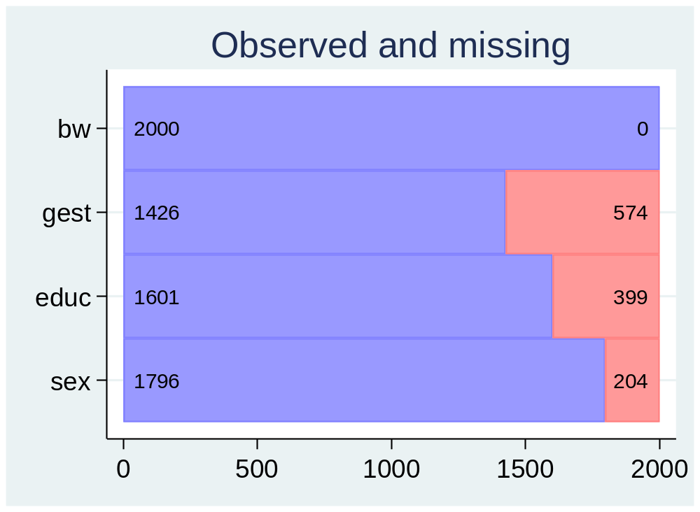
Matrix

Slide 8
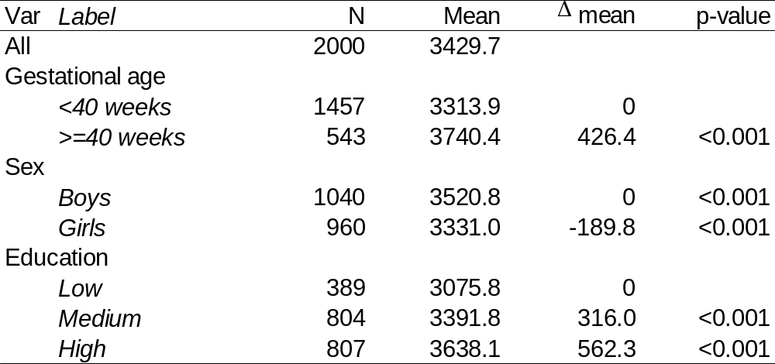
Result file: Table 1
Two string variables (var, lab)
Four numeric variables (obs, mean, dmean, pvalue)
Go to Syntax: Examples

Slide 9
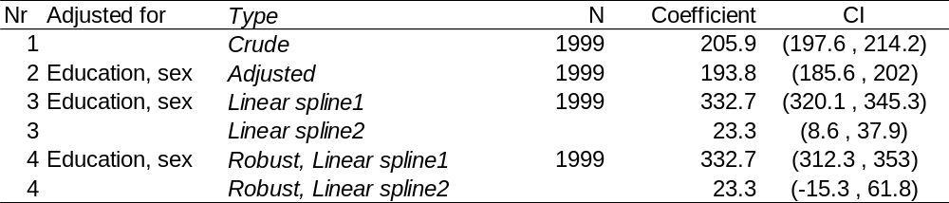
Result file: Table 2
Two string variables (adjSet, lab)
Five numeric variables (nr, obs, coef, ci1, ci2)

Slide 10
The end
Thanks for listening!

