Slide 1
Simulating Data and
Writing Programs
3h
Hein Stigum
Presentation, data and programs at:
Stata Course - Institutt for helse og samfunn (uio.no)
Apr-23
H.S.
1

Slide 2
Agenda
Simulating data
  Linear regression
  Logistic regression
  Survival analysis
Understand methods
Explore data problems
  Non linear effects
  Interactions
  Skewed distributions
  Outliers (Linear)
  Confounding (Logistic)
  Missing or Selection
  Measurement error
  Heteroscedasticity (Linear) (non-constant error variance)
  Sparse data bias (Logistic)
Programs basic
  Repeated simulations “simulate” command
  Bootstrap CI “bootstrap” prefix
  Simulate power “power” command
Notes:
Simulating data for linear regression: 30 min
Simulating data for logistic regression: 15 min
write program for logistic data simulation:
Sparse data bias, sim on logistic:
bootstrap on logistic bias
simulate power 15 min

Slide 3
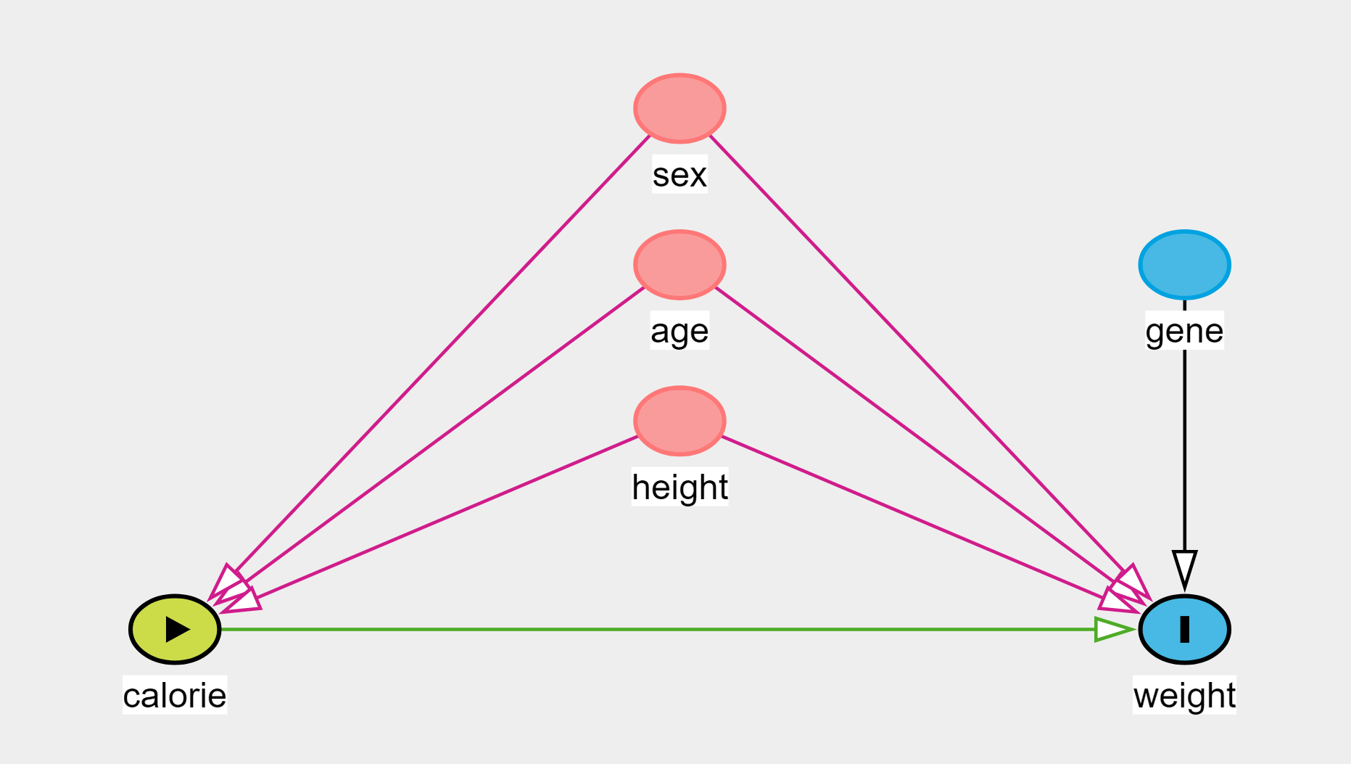
Calorie Intake and Weight
Simulate data from DAG
  Start with “parent” variables: sex, age, height, gene
  Exposure calorie
  Outcome weight

Slide 4
Go to syntax
Simulating Data and Writing Programs, Examples
“Simulating data for linear regression”

Slide 5
Conclusion: outliers
Linear regression is sensitive to outliers
  Outliers in both X and Y may bias the X-effect
  Outliers in only Y may increase the se(X)
Simulating outliers is easy

Slide 6
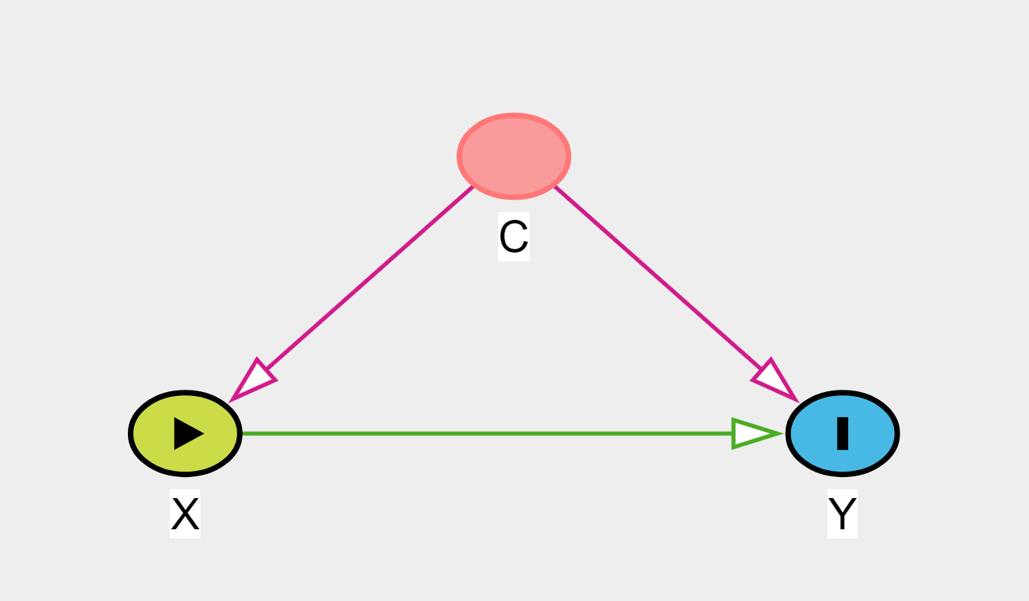
DAG for logistic regression data
binary
2
2
binary
binary
2
Simulate data from DAG
  Start with “parent” variable: C
  Exposure X
  Outcome Y

Slide 7
Go to syntax
Simulating Data and Writing Programs, Examples
“Simulating data for logistic regression”

Slide 8
Agenda
Simulating data
  Linear regression
  Logistic regression
  Survival analysis
Understand methods
Explore data problems
  Non linear effects
  Interactions
  Skewed distributions
  Outliers (Linear)
  Confounding (Logistic)
  Missing or Selection
  Measurement error
  Heteroscedasticity (Linear) (non-constant error variance)
  Sparse data bias (Logistic)
Programs basic
  Repeated simulations “simulate” command
    Confounding (Logistic)
    Sparse data bias (Logistic)
  Bootstrap CI “bootstrap” prefix
  Simulate power “power” command
Notes:
Simulating data for linear regression: 30 min
Simulating data for logistic regression: 15 min
write program for logistic data simulation:
Sparse data bias, sim on logistic:
bootstrap on logistic bias
simulate power 15 min

Slide 9
Go to syntax
Simulating Data and Writing Programs, Examples
“Writing Programs”

Slide 10
Sparse data bias
How many parameters can we estimate from a dataset?
  Linear regression: 10% of N
  Logistic regression: 10% of cases
What happens if the data is small relative to the number of parameters?
  “Sparse Data Bias”
Go to Excel:
Sparse Data Bias
(Greenland, Mansournia et al. 2016)

Slide 11
Go to syntax
Simulating Data and Writing Programs, Examples
“Simulating user written programs”

Slide 12
Agenda
Simulating data
  Linear regression
  Logistic regression
  Survival analysis
Understand methods
Explore data problems
  Non linear effects
  Interactions
  Skewed distributions
  Outliers (Linear)
  Confounding (Logistic)
  Missing or Selection
  Measurement error
  Heteroscedasticity (Linear) (non-constant error variance)
  Sparse data bias (Logistic)
Programs basic
  Repeated simulations “simulate” command
    Confounding (Logistic)
    Sparse data bias (Logistic)
  Bootstrap CI “bootstrap” prefix
  Simulate power “power” command
Notes:
Simulating data for linear regression: 30 min
Simulating data for logistic regression: 15 min
write program for logistic data simulation:
Sparse data bias, sim on logistic:
bootstrap on logistic bias
simulate power 15 min

Slide 13
Bootstrapping
Ordinary Confidence Intervals are “normal-based”
If you do not trust this, you can bootstrap:
  Statistical procedure that resamples a single dataset to create many simulated samples.
  The resampling is done with replacement.
  Do the estimation on all resampled datasets to calculate combined standard errors and to construct confidence intervals
  Bootstrapping in Stata requires the estimation to be defined as a program

Slide 14
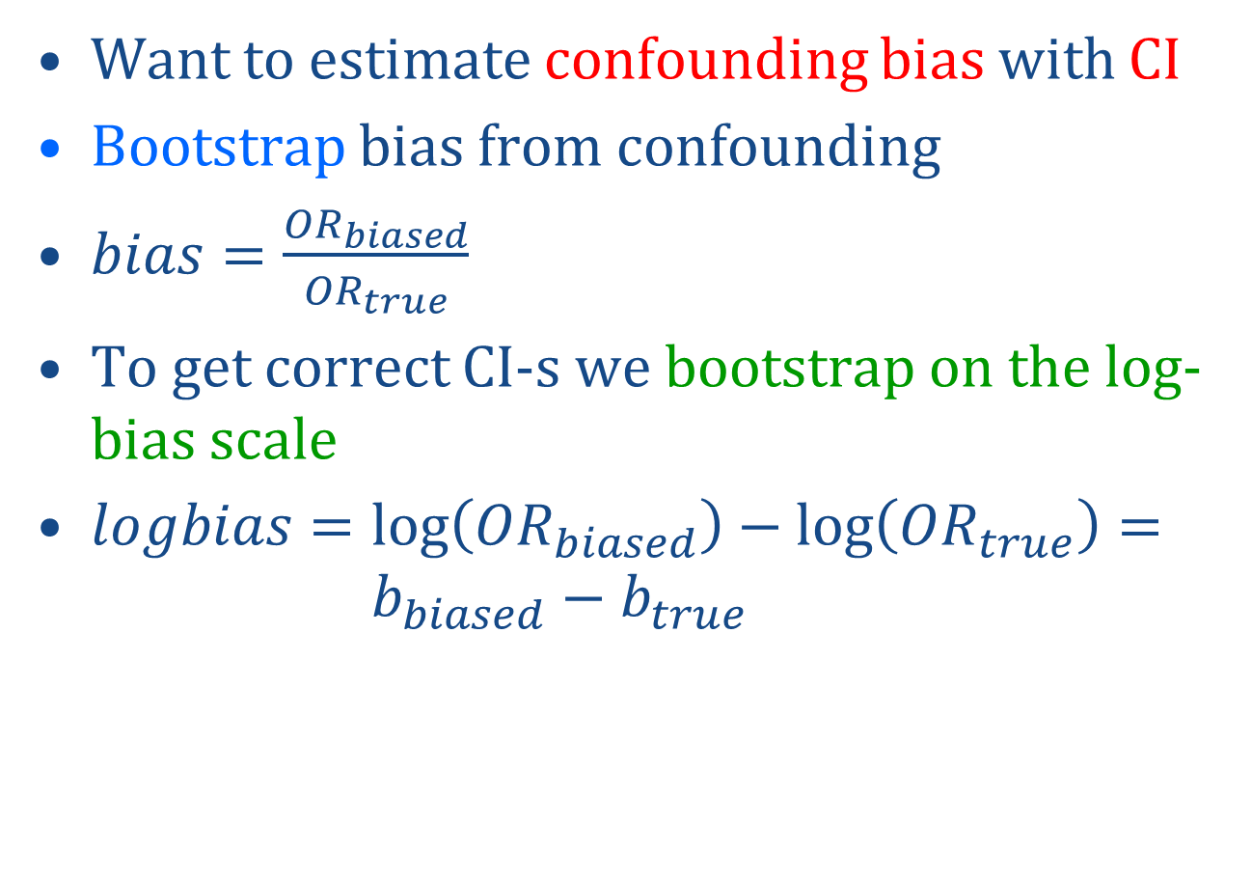
Confounding bias
Want to estimate confounding bias with CI
Bootstrap bias from confounding
$bias=\frac{{OR}_{biased}}{{OR}_{true}}$
To get correct CI-s we bootstrap on the log-bias scale
$logbias=\log\left({OR}_{biased}\right)−\log\left({OR}_{true}\right)={ b}_{biased} −{ b}_{true}$

Slide 15
Go to syntax
Simulating Data and Writing Programs, Examples
“Bootstrapping user written programs”

Slide 16
Simulating Power
Example
  National Health and Nutrition Examination Survey
  Age and sex interacts on blood pressure
  Plan a study to determine the interaction effect
  Want 80% power to detect an interaction parameter of 0.35.
  How large does the sample need to be?
Simulation
  Write a program to estimate the interaction.
  Count the % of times the interaction is significant
  This is the power!
Stata blog: 13 August 2019, Chuck Huber

Slide 17
Go to syntax
Simulating Data and Writing Programs, Examples
“Simulate power”

Slide 18
Summary
Simulate data for linear regression (DAG)
  Effect of outliers
Simulate data for logistic regression (DAG)
Define Program
  Effect of confounding
  Simulate: sparse data bias
  Bootstrap: confounding bias with CI
  Simulate: power of interaction term test
  Power: Chuck Huber Stata blog

