Slide 1
8 Individual Fixed Effects Regression
Jonathan Wörn
Presentation, data and programs at:
https://bit.ly/3ItnOGj

Slide 2
Today’s menu: Fixed effects
Idea & Examples
Model & Assumptions
Syntax, Interpretation, Sample Selection
Getting the data in shape
A real world example: Marriage & Happiness
Concluding remarks
Special thanks to Josef Brüderl at Ludwig-Maximilians-University München.
Parts of this presentation are based on his excellent lecture materials:
https://www.ls3.soziologie.uni-muenchen.de/downloads/downloads_lehre/teaching_materials/panelanalysis-bruederl.pdf

Slide 3
Idea & Examples

Slide 4
Fixed Effects
A method to get closer to causal estimates with non-experimental, observational data
Is change in X associated with change in Y?
Repeated measures / panel data
Rules out confounding from time-invariant factors
  Neither observed and unobserved factors
Notes:
Gold standard RCT: Random assignment into treatment & control
Not always possible: ethics, practicalities, … (marriage, smoking, unemployment, …)
Economics/social sciences

Slide 5

Examples

Slide 6

Examples

Slide 7
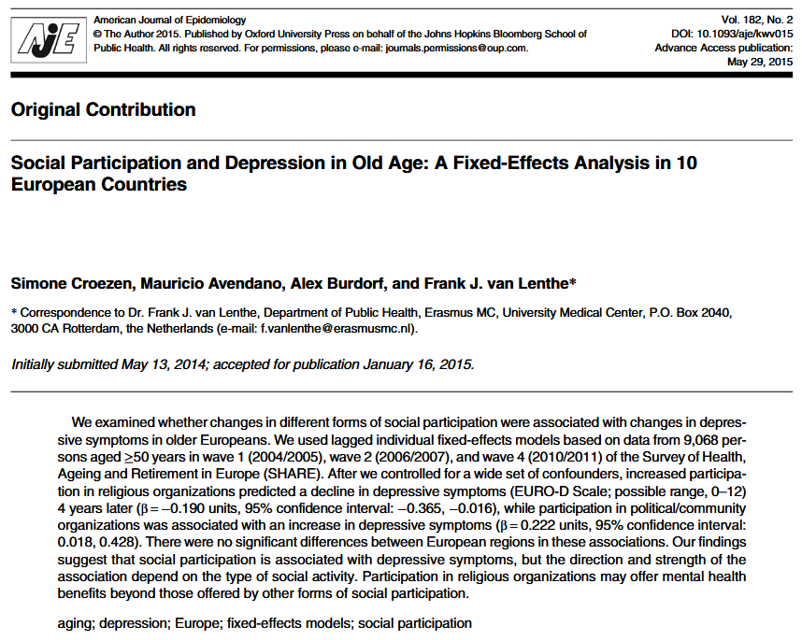
Examples

Slide 8
Idea
See Brüderl (2015)

Slide 9
Idea
Cross-sectional
regression
See Brüderl (2015)

Slide 10
Idea
Fixed effects regression
See Brüderl (2015)

Slide 11
Why not pooled OLS?
See Brüderl (2015)

Slide 12
Model & Assumptions

Slide 13
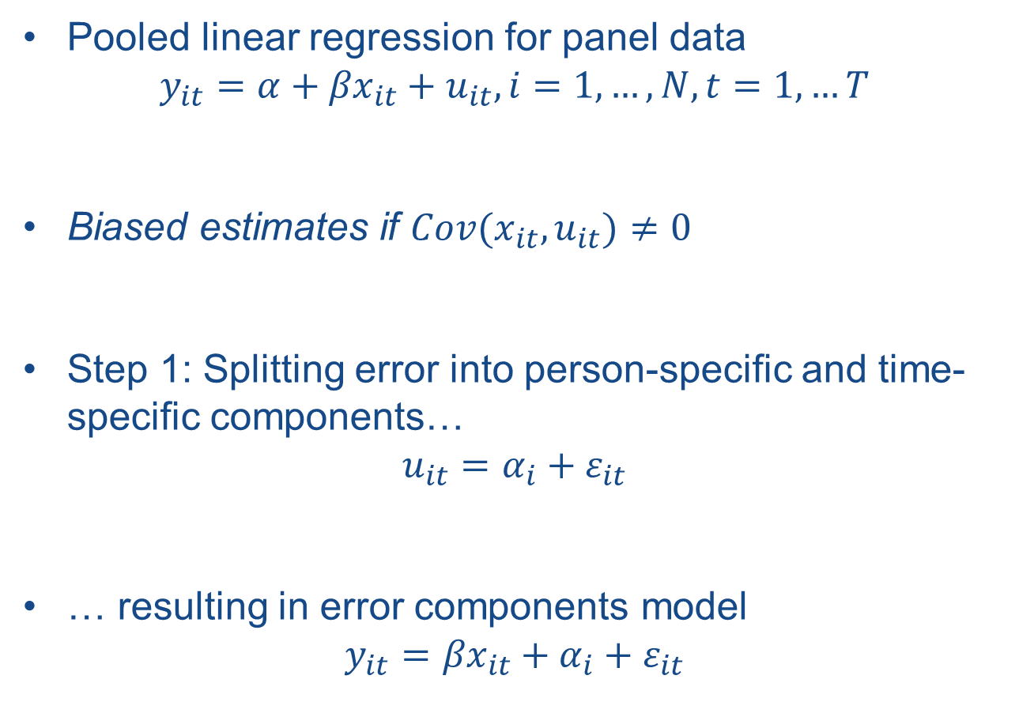
Model
Pooled linear regression for panel data
$$y_{it}=α+{βx}_{it}+u_{it}, i=1, …, N, t=1, …T$$
Biased estimates if $Cov(x_{it},u_{it})≠0$
Step 1: Splitting error into person-specific and time-specific components…
$$u_{it}=α_{i}+ε_{it}$$
… resulting in error components model
$$y_{it}={βx}_{it}+α_{i}+ε_{it}$$
Notes:
In the last equation, the overall constant α has been dropped due to collinearity (Brüderl 2015)

Slide 14
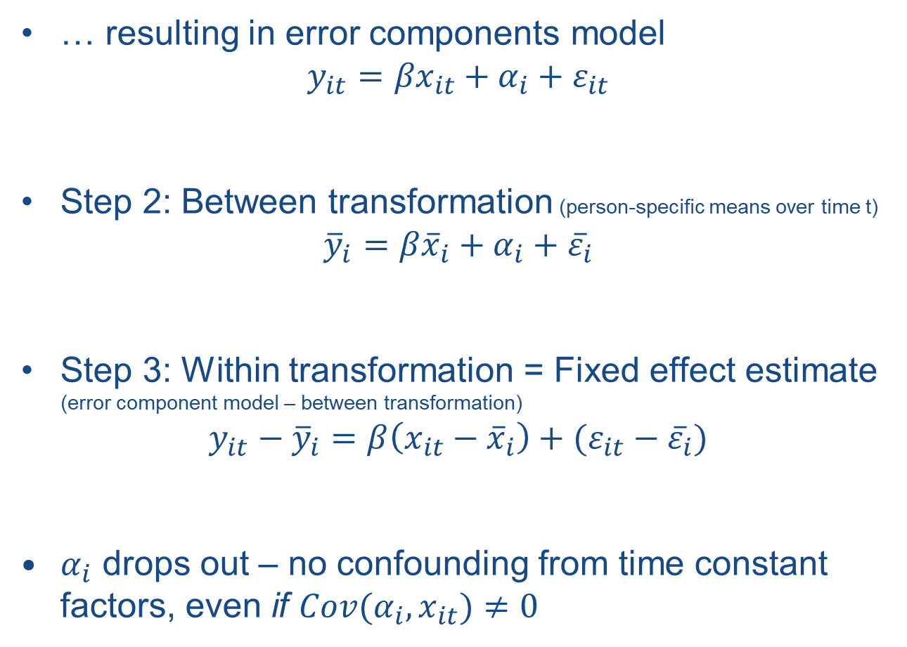
Model
… resulting in error components model
$$y_{it}={βx}_{it}+α_{i}+ε_{it}$$
Step 2: Between transformation (person-specific means over time t)
${\overline{y}}_{i}={β\overline{x}}_{i}+α_{i}+{\overline{ε}}_{i}$
Step 3: Within transformation = Fixed effect estimate
(error component model – between transformation)
$${y_{it}−\overline{y}}_{i}=β\left(x_{it}−{\overline{x}}_{i}\right)+(ε_{it}−{\overline{ε}}_{i})$$
$α_{i}$ drops out – no confounding from time constant factors, even if $Cov(α_{i},x_{it})≠0$

Slide 15
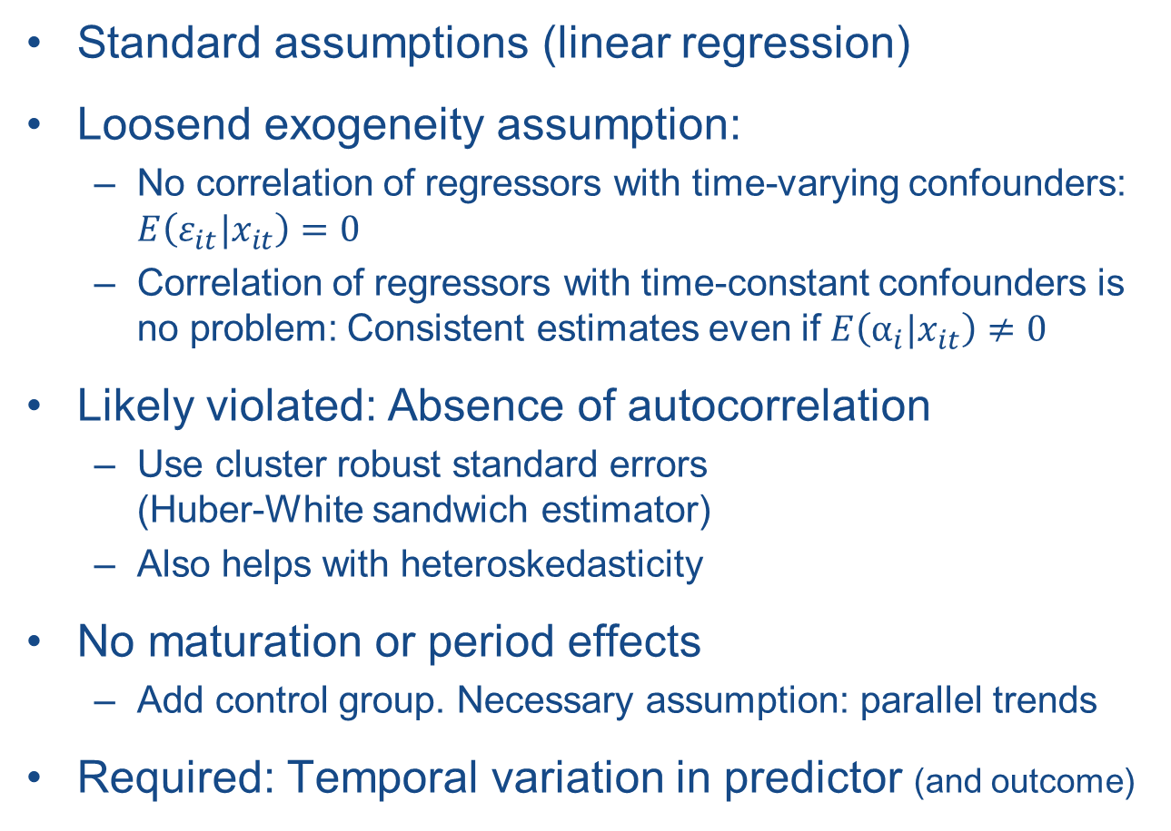
Assumptions and Requirements
Standard assumptions (linear regression)
Loosend exogeneity assumption:
  No correlation of regressors with time-varying confounders: $E\left(ε_{it}|x_{it}\right)=0$
  Correlation of regressors with time-constant confounders is no problem: Consistent estimates even if $E\left(α_{i}|x_{it}\right)≠0$
Likely violated: Absence of autocorrelation
  Use cluster robust standard errors
  (Huber-White sandwich estimator)
  Also helps with heteroskedasticity
No maturation or period effects
  Add control group. Necessary assumption: parallel trends
Required: Temporal variation in predictor (and outcome)

Slide 16
Syntax, Interpretation,
Sample Selection

Slide 17
Syntax
xtreg depvar indepvars, fe vce(cluster id)
  xtreg, fe: FE-model
  vce(cluster id): robust standard errors
  Command requires prior xtset. See „Getting the data in shape“

Slide 18
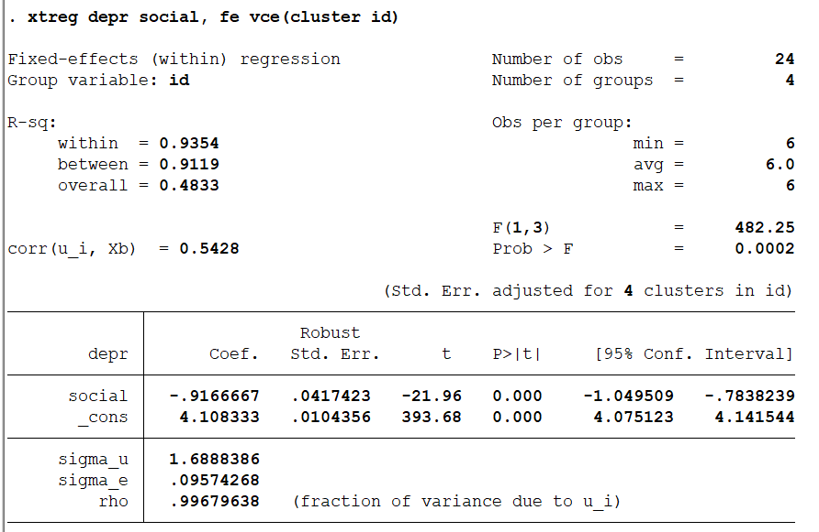
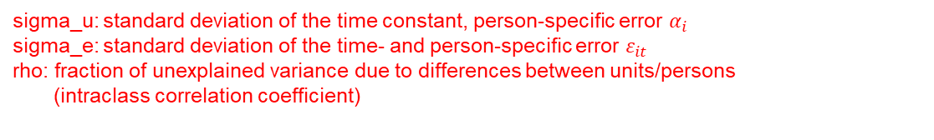
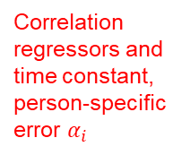

Interpretation
Observations
Persons
Correlation regressors and time constant, person-specific error $α_{i}$
Stata adds back a constant
sigma_u: standard deviation of the time constant, person-specific error $α_{i}$
sigma_e: standard deviation of the time- and person-specific error $ε_{it}$
rho: fraction of unexplained variance due to differences between units/persons
(intraclass correlation coefficient)
See Hamilton (2005)
$$rho=\frac{{(sigma_u)}^{2}}{{(sigma_u)}^{2}+{(sigma_e)}^{2}}$$
Notes:
Constant:
Wooldridge: average of individual-specific intercepts ($α_{i}$)
Brüderl (2015): mean outcome when xit = 0
https://www.stata.com/support/faqs/statistics/intercept-in-fixed-effects-model/

Slide 19
Interpretation
Descriptive interpretation
  After participating in social activities, respondents‘ depressive symptoms are .92 units lower than before participating in social activities
  Always correct
Causal interpretation
  Participating in social activities reduces respondents‘ depressive symptoms by .92 units
  Correct if exogeneity assumption holds
See Brüderl (2015)

Slide 20
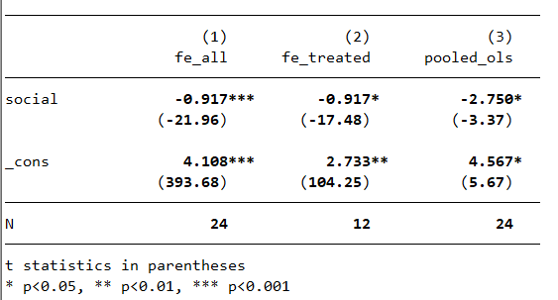
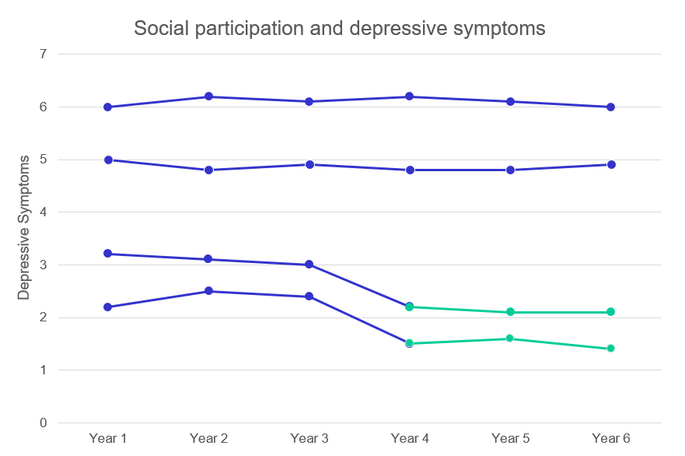
Effect-estimate: only treated units
Only persons being treated contribute to effect-estimate
  M1: FE with 2 treated persons, 2 non-treated persons
  M2: FE with 2 treated persons
  M3: pooled OLS with 2 treated and 2 non-treated persons

Slide 21
Maturation and period effects

Slide 22
Maturation and period effects
Coefficients will be biased by
  Time trends
  Age effects
  Period effects
Wrongly attribute temporal effect to treatment
Always include time and control group in the model!
  Control group: „at risk“ but not treated
  Assumption: Parallel trends in treatment and control
  If different trends: biased estimates
Notes:
“Fixed effects with individuals slopes” as an approach to deal with non-parallel slopes

Slide 23
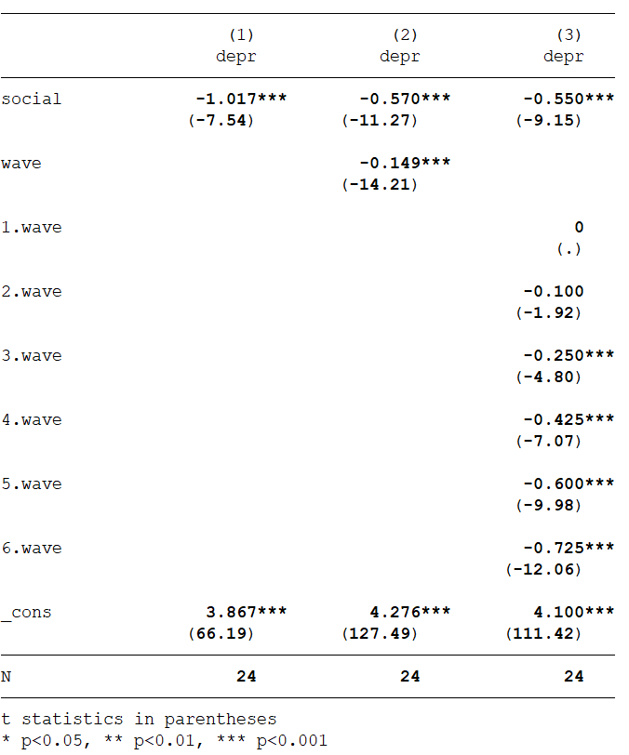
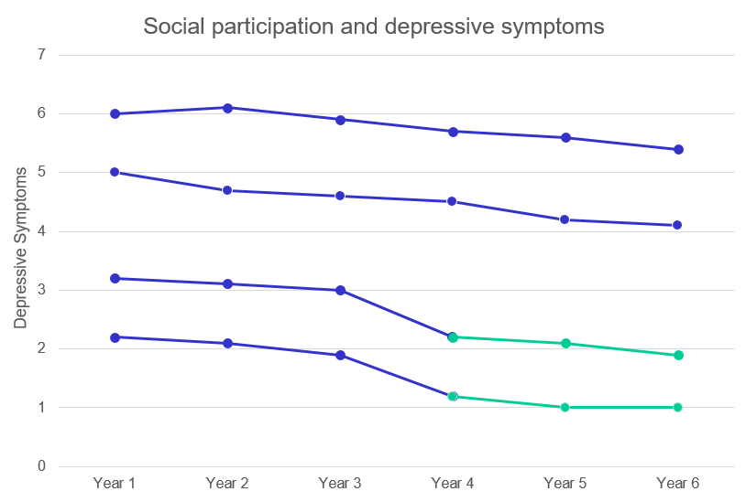
Maturation and period effects
Accounting for time: smaller coefficient for treatment
M1: xtreg depr social, fe vce(cluster id)
M2: xtreg depr social wave, fe vce(cluster id)
M3: xtreg depr social i.wave, fe vce(cluster id)

Slide 24
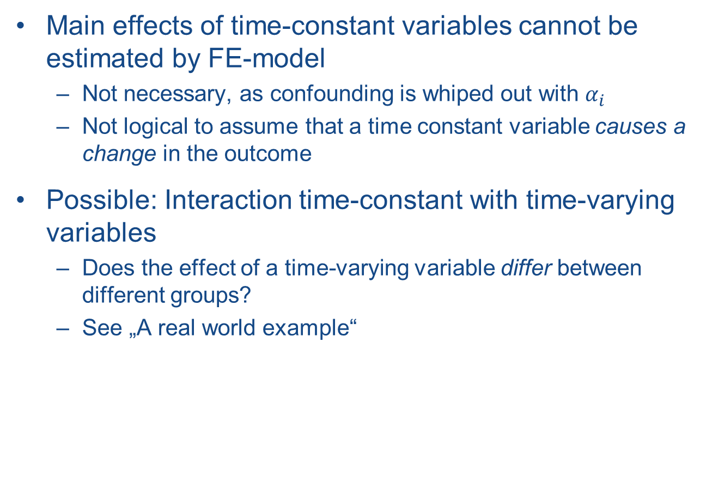
Time constant variables
Main effects of time-constant variables cannot be estimated by FE-model
  Not necessary, as confounding is whiped out with $α_{i}$
  Not logical to assume that a time constant variable causes a change in the outcome
Possible: Interaction time-constant with time-varying variables
  Does the effect of a time-varying variable differ between different groups?
  See „A real world example“

Slide 25
Sample selection
Include only persons who can potentially change from the state of not being treated to the state of being treated
  In example: those not participating in social activities (yet)
  When studying effects of marriage: those not (yet) married

Slide 26
Sample selection
Think carefully how to handle persons that change to yet another state than treated later on
  In studies of marriage effects:
  never married → married → divorce
  Keep?
  Exclude the person completely?
  Exclude only time points (“observations”) while divorced, but keep while never married and married?
  (substantial considerations)

Slide 27
Sample selection
Exclude persons with only one observation
  They cannot provide a within estimation
Consider including a control group
  Those that are “at risk” / not treated
  AND will not be treated during the observation period
  Allows controlling for time/age

Slide 28
Problems not solved by FE-models
Endogeneity
  reversed causality
  time-varying confounders
  …
Panel attrition associated with time-variant factors
Selection into treatment
  Treatment effect on the treated

Slide 29
Getting the data in shape

Slide 30
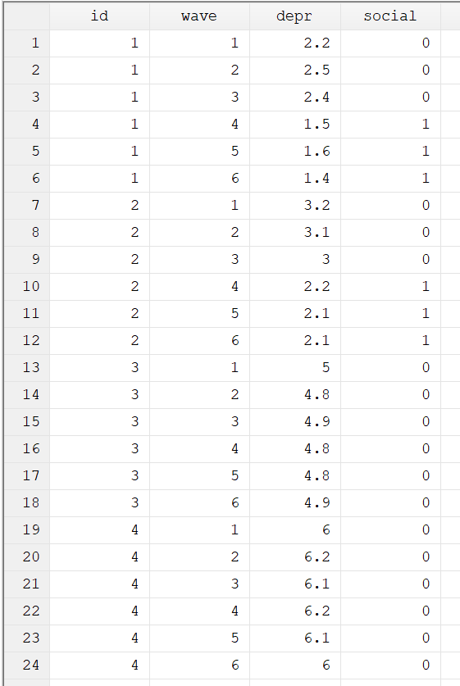
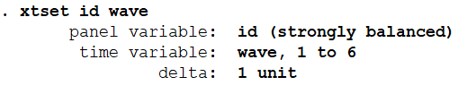
Data format
panelvar
timevar
Long data format
  Multiple lines per person
  Each line = 1 time point
xtsetting long data
  xtreg, fe requires xtset
  xtset panelvar timevar
  [, options]

Slide 31
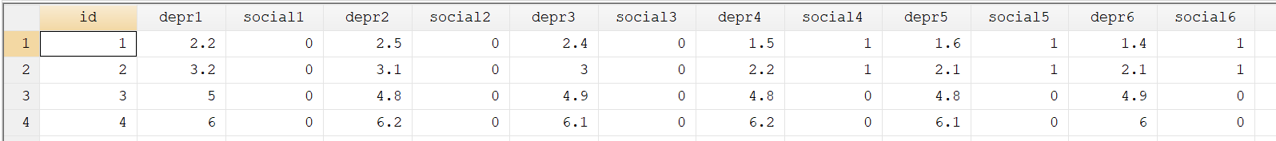
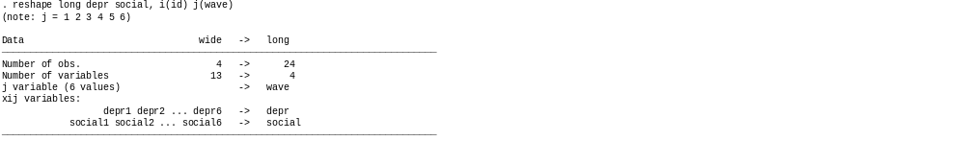
Digression:
Transforming wide to long format

Slide 32
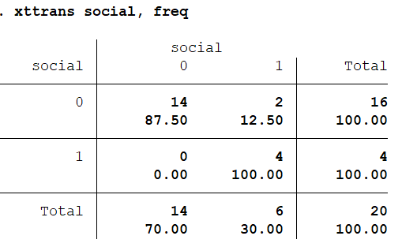
Describing xtset-data
Describe transitions between statuses:
xttrans varname [, freq]
freq-option gives numbers in addition to percentages

Slide 33
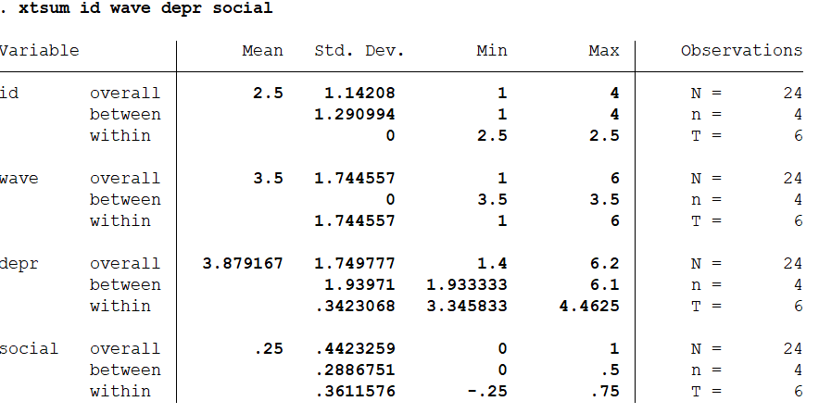
Describing xtset-data
Describe variables: xtsum varlist
Varies only
between persons
Varies only
within persons
“Enough” within-
variation in treatment?
More info about xtsum and its interpretation: https://www.stata.com/manuals/xtxtsum.pdf
Notes:
More info about xtsum and its interpretation: https://www.stata.com/manuals/xtxtsum.pdf

Slide 34
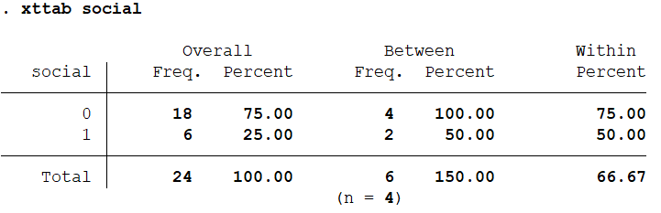
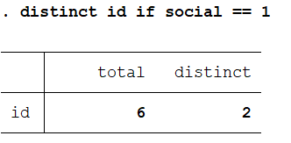
Describing xtset-data
Tabulate variables: xttab varlist
Also: distinct-command
to identify IDs with
certain features
Observation/timepoint-level
Unit/person-level

Slide 35
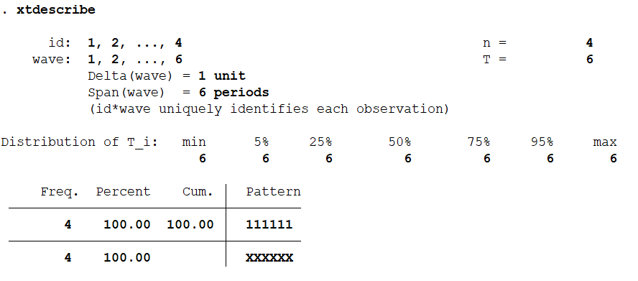
Describing xtset-data
Useful for patterns of missingness:
xtdescribe [, width(#) patterns(#)]
  Width of participation patterns (default: 100)
  Patterns: maximum number of patterns (default: 9)

Slide 36
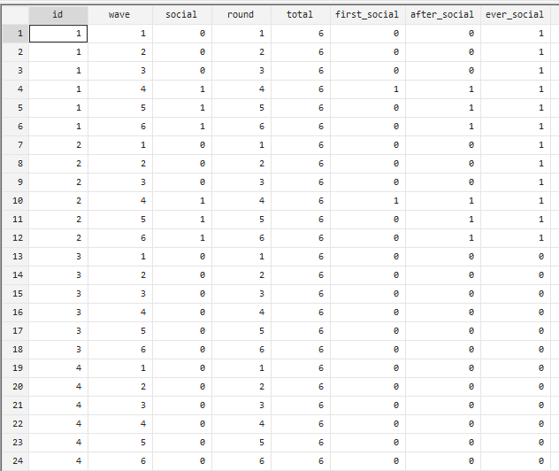
Useful commands for long data

Slide 37
Useful commands for long data
bysort: repeat command on subsets
  Sort and execute for each id and each wave:
  bysort id wave
  Sort by id and wave, but execute by id:
  bysort id (wave)
Counting:
  Running count: gen run = _n
  Overall count: gen count = _N
egen: extensions to generate
  egen newvar = fcn(arguments) [, options]
  fcn: min(exp), max(exp), and many more

Slide 38
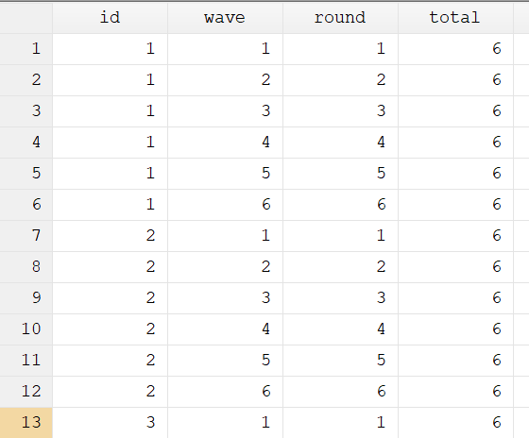
Useful commands for long data
Powerful combinations:
  bysort id (wave) : gen round = _n (each person: number rows in correct order)
  bysort id : gen total = _N (each person: how many rows)

Slide 39
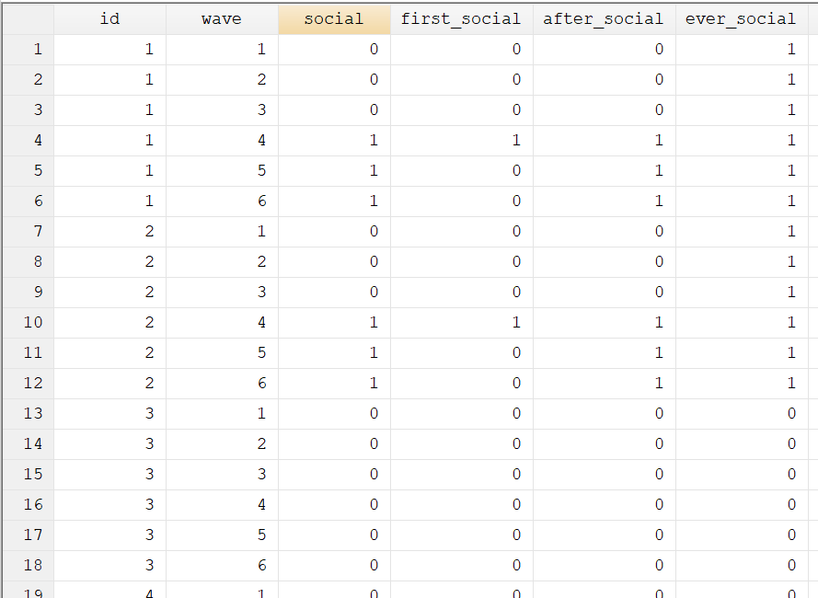
Useful commands for long data
Goal: Finding first treatment, after treatment, ever treated

Slide 40
Useful commands for long data
Goal: Finding first treatment, after first treatment, ever treated
First treatment:
  bysort id (wave) :
  gen first_social = sum(social == 1) == 1 & sum(social[_n - 1] == 1) == 0
After first treatment
  bysort id (wave) : gen after_social = sum(first_social)
Tagging all observations of persons ever treated
  bysort id : egen ever_social = max(social)
Is 1 if condition is true: social is 1 in row _n and is not 1 in row _n-1
Is 0 otherwise.
Running sum of first_social up until wave _n, for person i
Finds the maximum of social (0 or 1) for each person

Slide 41
A real world example:
Marriage & Happiness

Slide 42
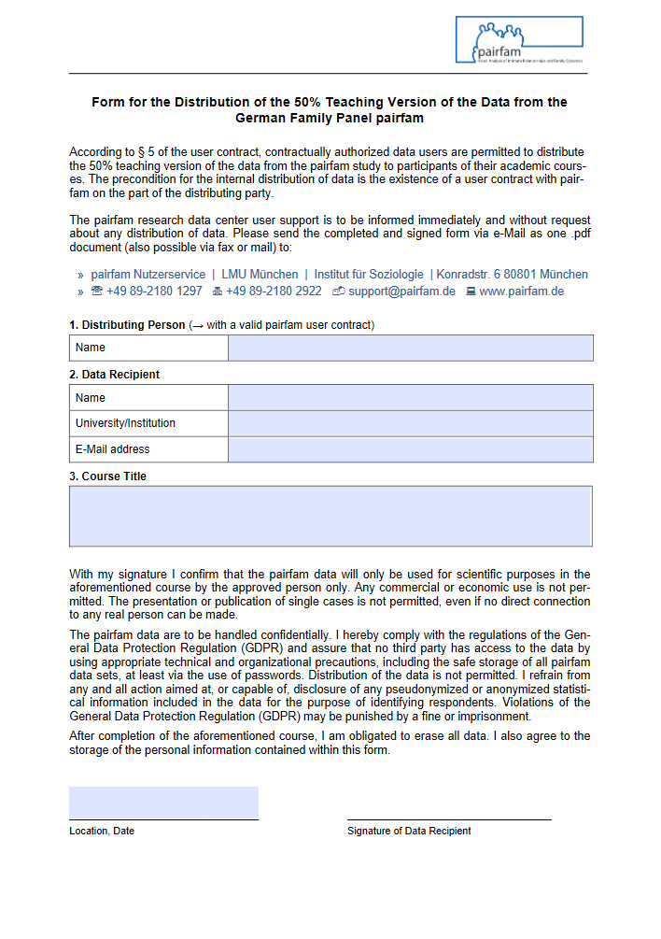
A real world example
Does marriage make happy?
Based on a 50%-subsample from the German Family Panel
  11 waves (2009-2019)
  12.000 respondents, plus their partners, children, and parents
  Born 1971-73, 1981-83, 1991-93 und 2001-03
  https://www.pairfam.de/
Log-file with syntax and output is available on course homepage
For data access: Fill in data access form and send to me:
  https://www.pairfam.de/fileadmin/user_upload/
  uploads/Covid-19/Antragsformular/
  DistributionTeachingVersion_pairfam11.0
  _COVID-19_en.pdf

Slide 43
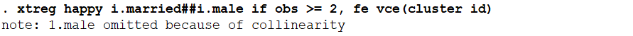
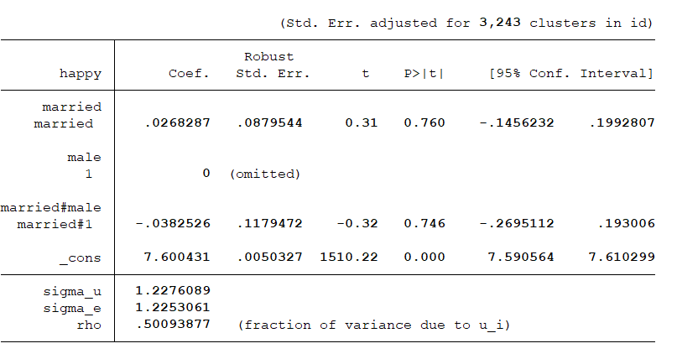
Interaction with constant variables
Effect of married when
male == 0 (i.e., for women)
Not estimated b/c
constant over time
DIFFERENCE in effect of married
between men vs. women (n.s.).
Effect of being married for men:
0.0268+(-0.0383)=-0.0114

Slide 44
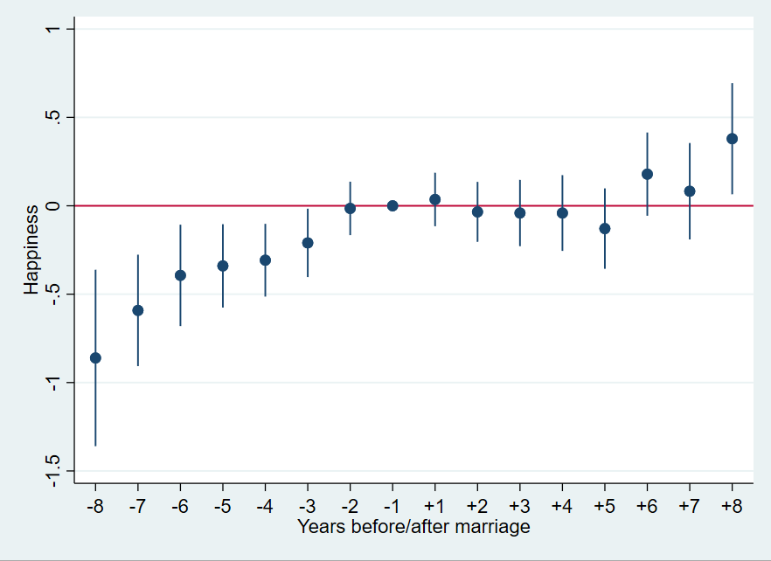
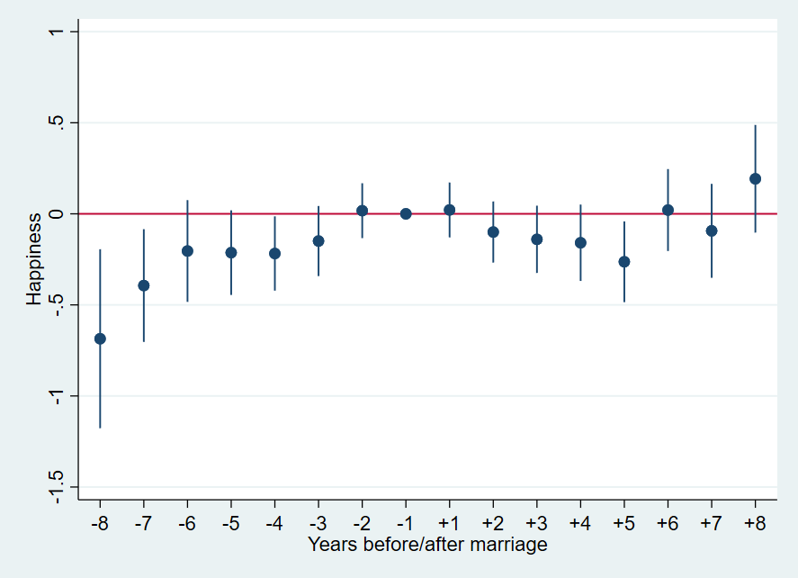
Impact functions using dummies
Controlling for wave-dummies
Not controlling for wave-dummies
Dummy variables indicating years since marriage
  Factor-notation in Stata
  Set variable „years since marriage“ to a constant value (e.g. 10000) instead of missing → included in model as control group
Plot: coefplot-ado
See 9-fixed-effects-regression_example.do / .smcl

Slide 45
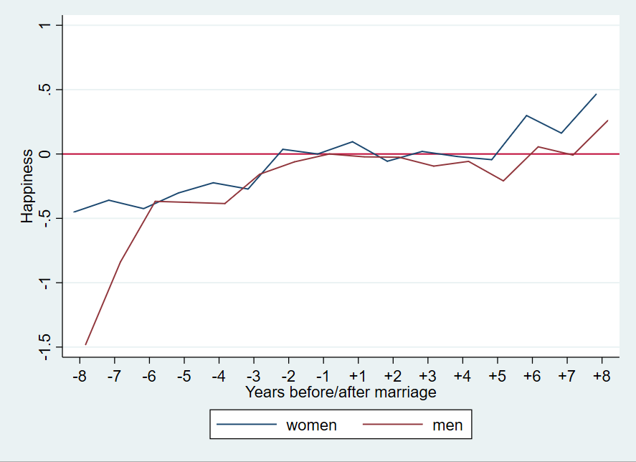
Impact functions using dummies
See 9-fixed-effects-regression_example.do / .smcl

Slide 46
Concluding remarks

Slide 47
Application to other data structures
Applicable to other panel data structures
  Children in families
  Children in schools
  Areas within countries
  …
Model will exploit the variation within…
  families (different children)
  schools (different children)
  countries (different areas)
  …
  … and whipe out specifics of families, schools, countries, etc

Slide 48
Summary individual fixed effects
Approaching causality with panel data
Uses within-variation
Controls time-constant factors
xtset and xtreg, fe vce(cluster id)
Model
  Include those not treated at outset
  Include control group and control for time

Slide 49
References
Allison, P.D. (2009). Fixed effects regression models. SAGE Publications, doi.org/10.4135/9781412993869
Best, H., & Wolf, C. (Eds.) (2014). The SAGE handbook of regression analysis and causal inference. SAGE Publications, doi.org/10.4135/9781446288146
Brüderl, J. (2015). Applied Panel Data Analysis Using STATA. Course Material, available at https://www.ls3.soziologie.uni-muenchen.de/downloads/downloads_lehre/teaching_materials/panelanalysis-bruederl.pdf
Gould, W.G. (n.d.). How can there be an intercept in the fixed-effects model estimated by xtreg, fe?, available at https://www.stata.com/support/faqs/statistics/intercept-in-fixed-effects-model/
Gunasekara, F.I., K. Richardson, K. Carter, T. Blakely. Fixed effects analysis of repeated measures data, International Journal of Epidemiology, Volume 43, Issue 1, February 2014, Pages 264–269, https://doi.org/10.1093/ije/dyt221
Hamilton, L.C. (2005). Statistics with STATA. Thomson, Belmont.
Torres-Reyna, O. (2007). Panel Data Analysis Fixed and Random Effects using Stata. Course Material available at https://www.princeton.edu/~otorres/Panel101.pdf
Wooldridge, J.M. (2009). Introductory Econometrics: A Modern Approach. South-Western. ISBN: 9780324581621

