Slide 1
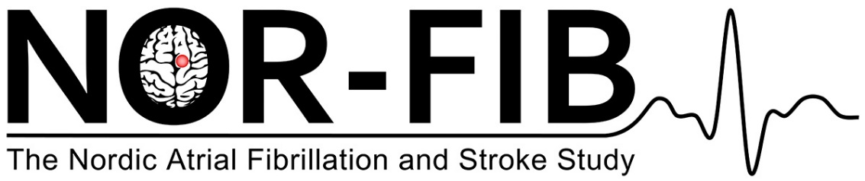
Hunting for the underlying causes and links:
Atrial Fibrillation in Cryptogenic Stroke and TIA.
Barbara Ratajczak-Tretel, MD
Østfold Hospital Trust, Norway
University of Oslo, Norway
Notes:
I will be presenting the preliminary results from the NOR-FIB study

Slide 2

Background
Significant proportion of ischemic strokes and TIA caused by
underlying AF are classified as cryptogenic – standard cardiac rhythm
monitoring is often insufficient in detecting paroxysmal AF
PAF can be detected in up to 25% of patients with cryptogenic
ischemic stroke and TIA if cardiac rhythm monitoring is prolonged
(*EMBRACE, SURPRISE, CRYSTAL AF)
Current American and European Stroke Guidelines still recommend
secondary prevention with antiplatelet agents to prevent stroke
recurrence in patients diagnosed with cryptogenic stroke and TIA
Oral anticoagulation is recommended only when AF is detected
(*NAVIGATE-ESUS)
Notes:
One of the most important goals of stroke and TIA treatment is to clarify stroke cause and optimise secondary prevention. But despite a modern extensive diagnostic work-up, up to 30-40% of all ischemic stroke and TIA cases remain classified as cryptogenic. That means that we do not know what the cause of the ischemic event was. Significant proportion of those patients might have underlying AF, that is missed because standard cardiac rhythm monitoring is often insufficient in detecting paroxysmal AF. Further investigation of cardiac rhythm is therefore important as the detection of AF has therapeutic implications on patient care. PAF can be detected in up to 25% of patient with cryptogenic ischemic stroke and TIA if cardiac rhythm monitoring is prolonged, this is proven in previous studies.

Slide 3

Aim and method
International, on-going, prospective, multicenter, observational study to evaluate the occurrance of occult AF in cryptogenic stroke and TIA.
All patients have a Medtronic Reveal LINQ® Insertable cardiac monitor implanted for 12 months
Blood samples analysis of biomarkers predicting AF at inclusion and at 12 months follow-up.
Periodes of AF ≥ 2 minutes are assessed for the risk of thromboembolism, if detected treatment with anticoagulant is started
Estimate number of patients to be included is 500
NCT 02937077, EudraCT 2018-002298-23
Notes:
The NOR-FIB study was started i 2017 to give patients with cryptogenic stroke and TIA opportunity for better and modern diagnostic work –up. This is an international, on-goin, prospective, multicenter, observational study that collects data from patients admittet with cryotogenic stroke/TIA without previously documented history of AF. Purpose is to evaluate the occurrance of occult AF in cryptogenic stroke and TIA, better understand the significance of changes in AF burden over time and the risk of reccurrent stroke. Biomarkers which can be used in clinical practice as predictors of incient AF are studied. All patients have a Medtronic Reveal LINQ ICM implanted for 12 months. We collect blood samples for biomarkers analysis.

Slide 4
Ischemic stroke / TIA
Ischemic stroke/TIA
Baseline
Etiological assessment
CTA/MRA
ECG, 24 h Holter
TTE/TEE
Carotid/Transcranial
Doppler ultrasound
Laboratory data
Flowchart
Yes
Subject not considered for study
Etiology
determined?
No
Meet
entry criteria?
No
Subject not considered for study
≤ 14 days*
*Denmark: 3 months
Yes
Enrollement
Biomarkers
Implant Reveal Linq©, start of monitoring for one year*
* After informed consent
** Clinical assessment, functional level, new vascular events, ECG/long-term ECG, concomitant medication and anticoagulants, adverse events and bleeding complications. Blood samples for biomarkers.
Biomarkers
180-Day Follow-up
(telephone interview)
365-Day Follow-up**
Notes:
Here is the flow chart. All patient are screened with CT/MRI, have done ultrasound and CTA/MRA, cardiac and arhythmia screening and ecco. If classified as cryptogenic according to the etiological assessment and they fulfill criteria the implantation of Reveal is done as soon as possible and cardiac monitoring starts. Periods of AF > 2 min are assessed for the risk of thromboembolism.

