Slide 1


Erfaringer fra 4 år som SFU
Anders Malthe-Sørenssen,
Professor, Department of Physics, University of Oslo, Director, Center for Computing in Science Education

Slide 2

Develop materials and methods
Build educational research group
Vision “an international hub for research-based integration of computational methods in education”
Build culture for teaching and learning
Disseminate nationally and internationally

Slide 3
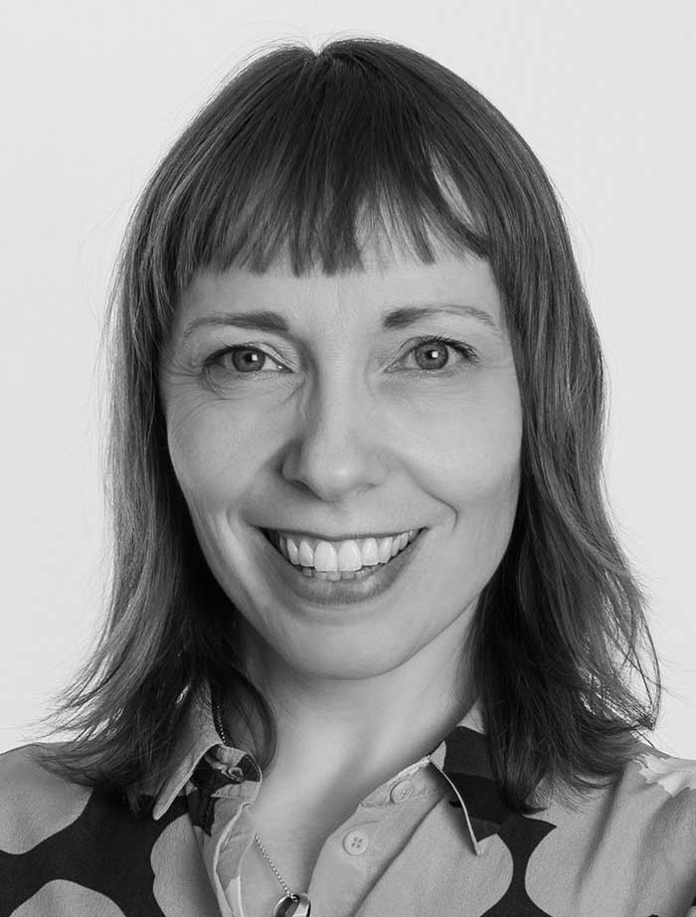
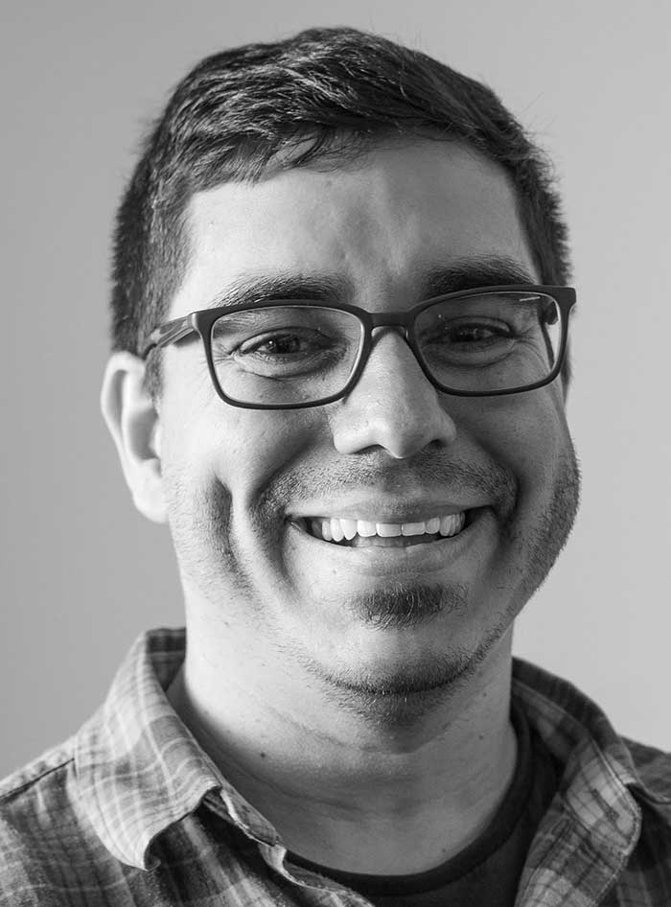
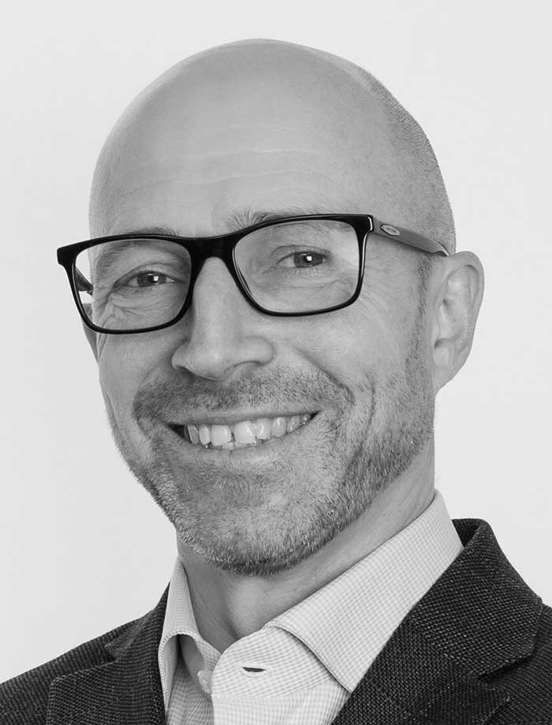
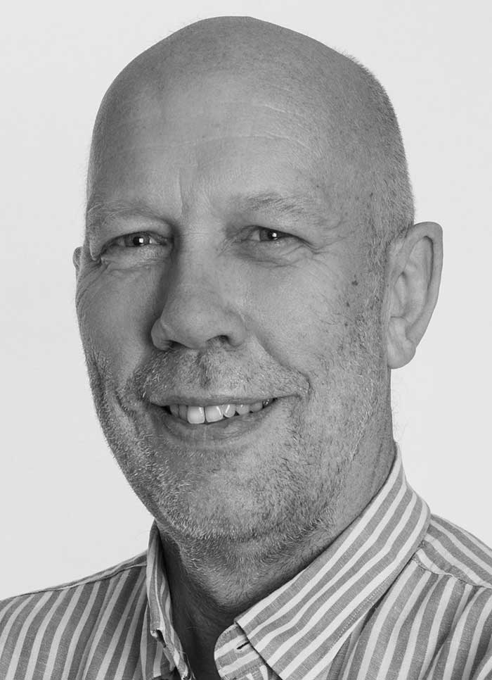
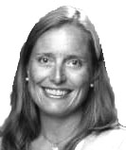
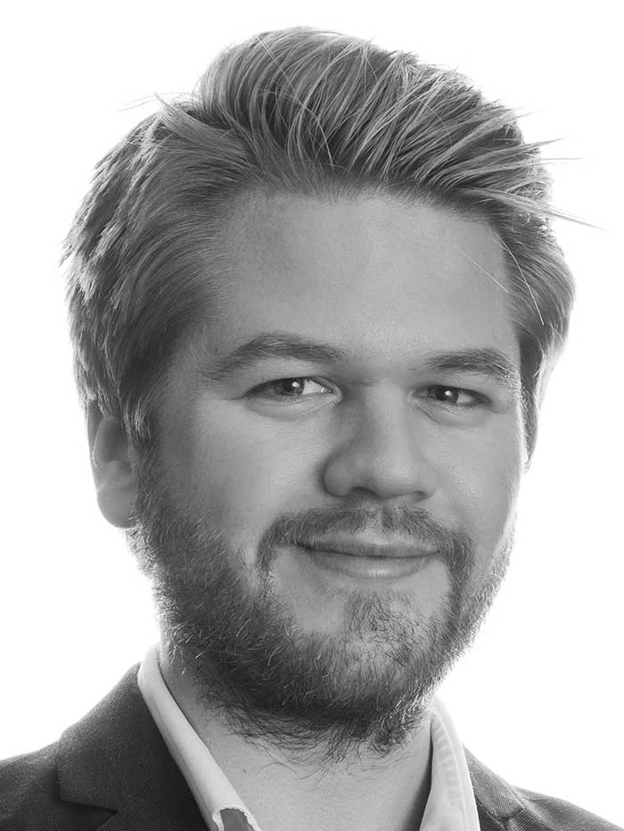
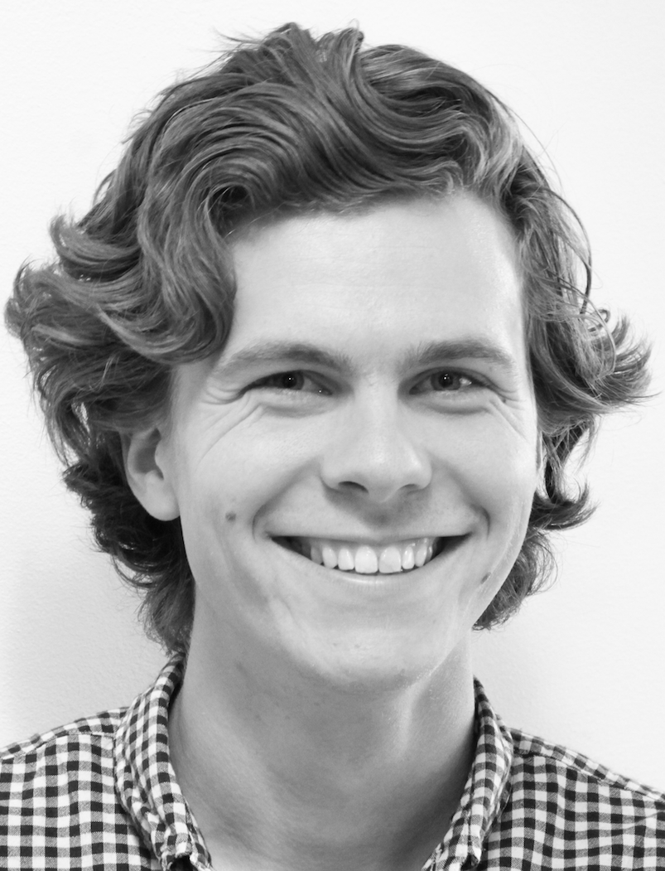
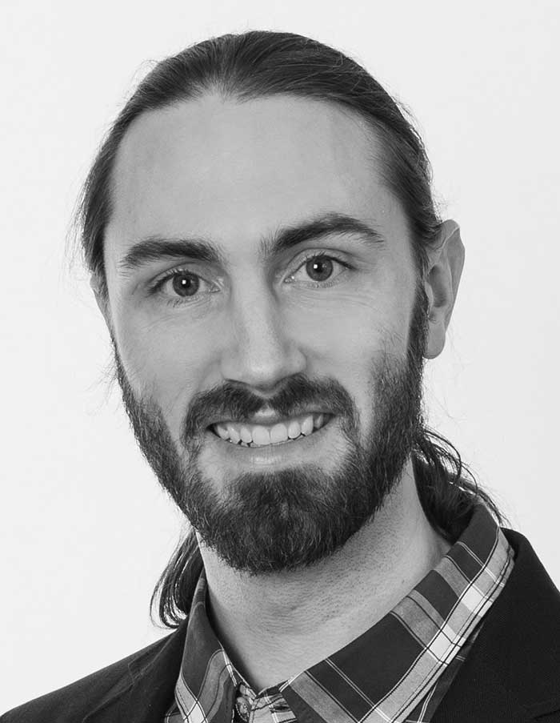
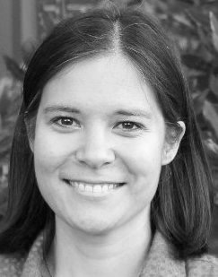
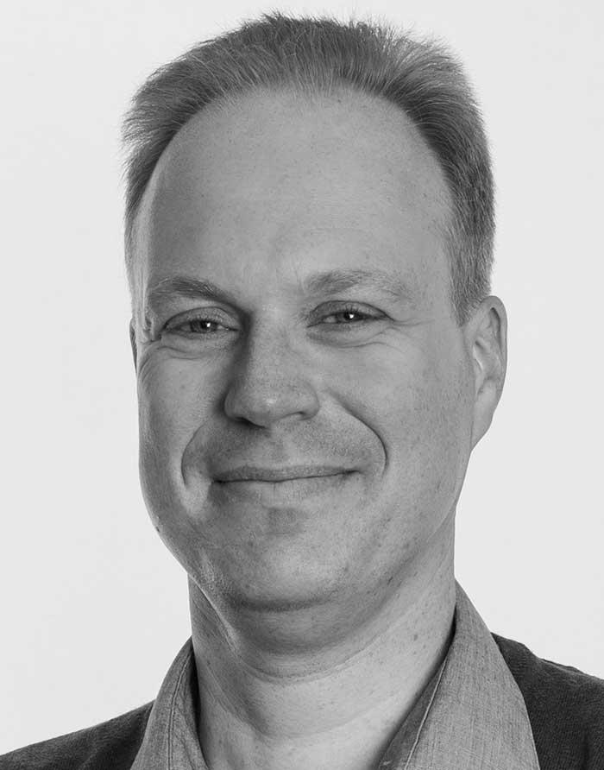
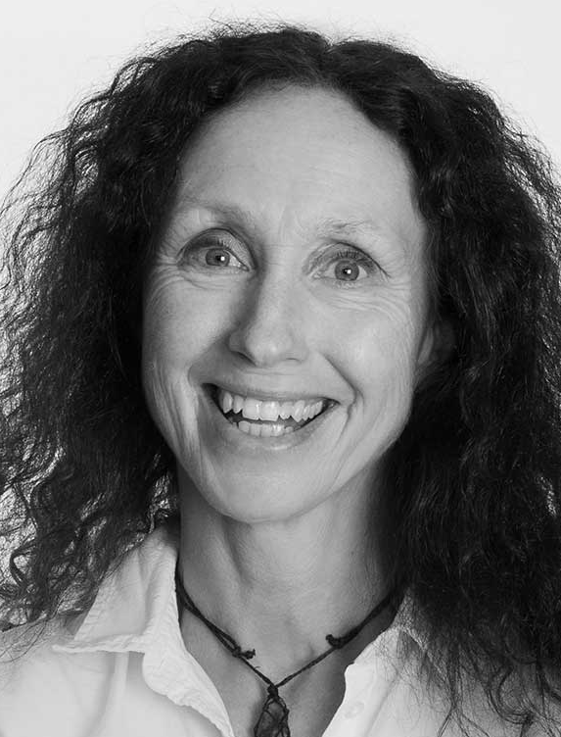
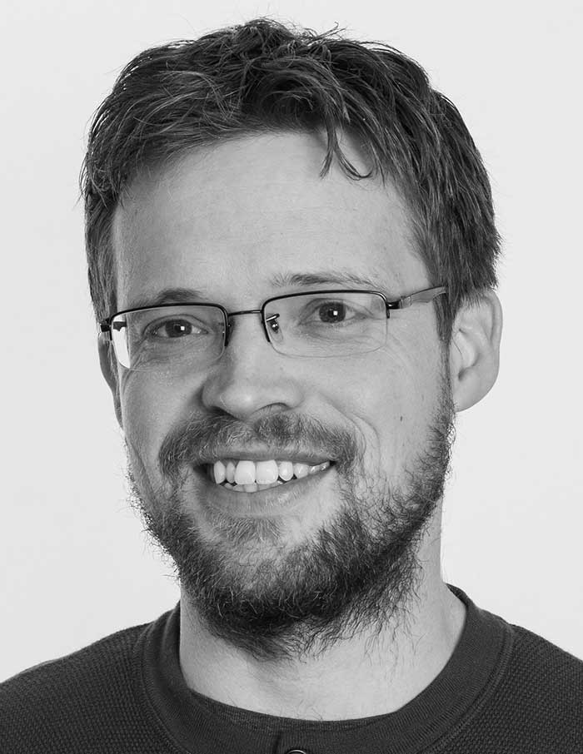
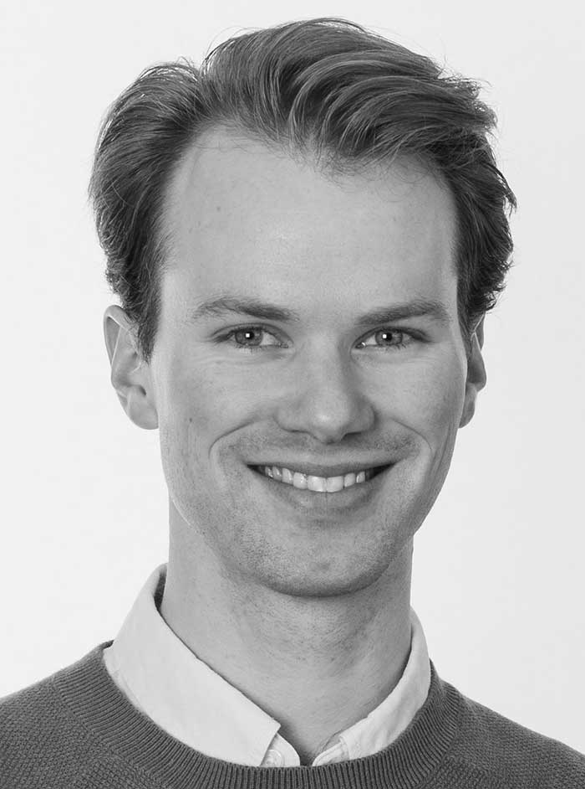
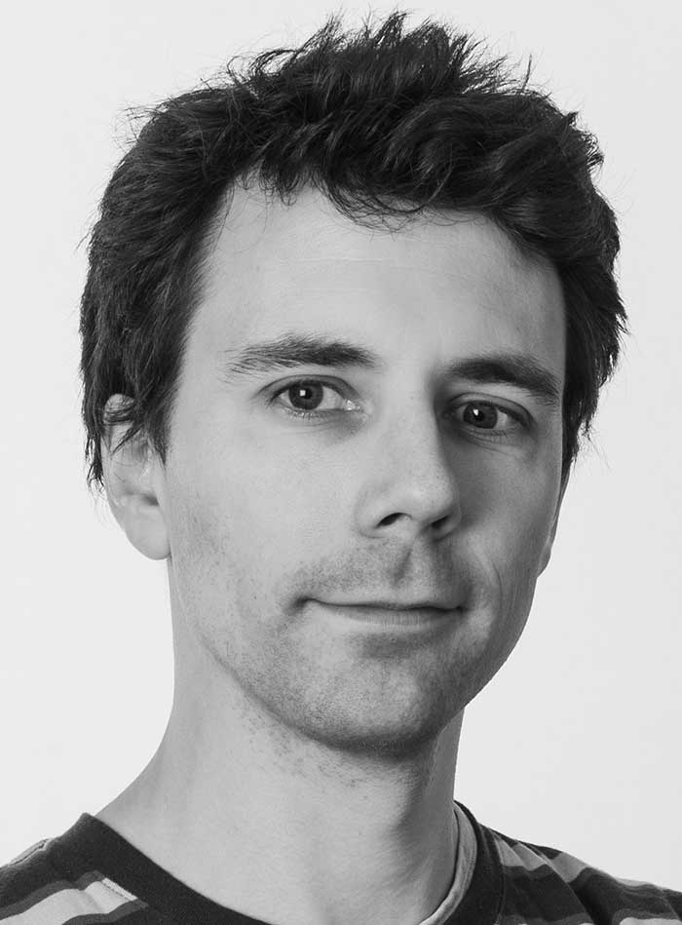
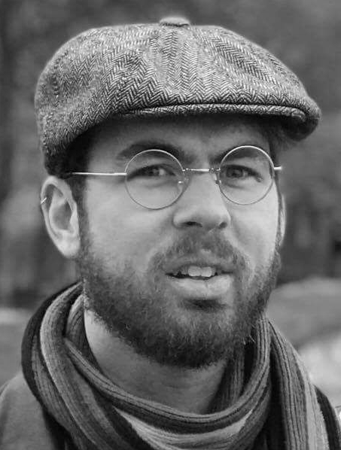
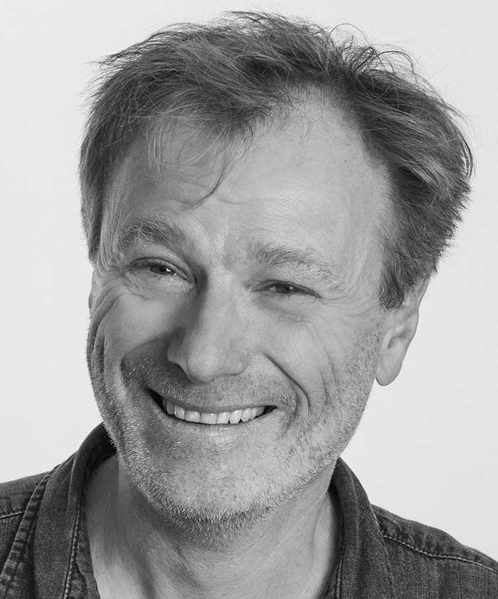
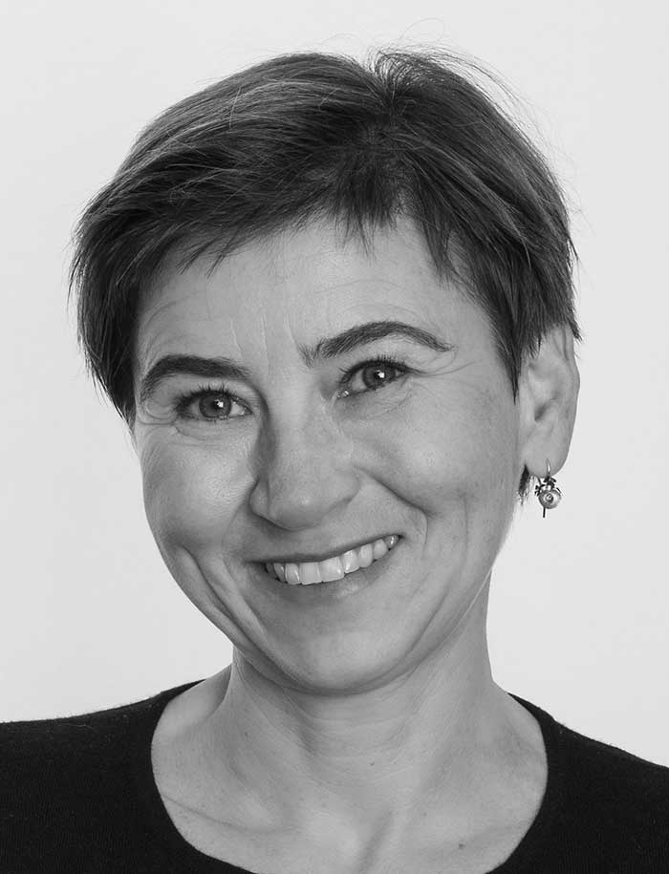
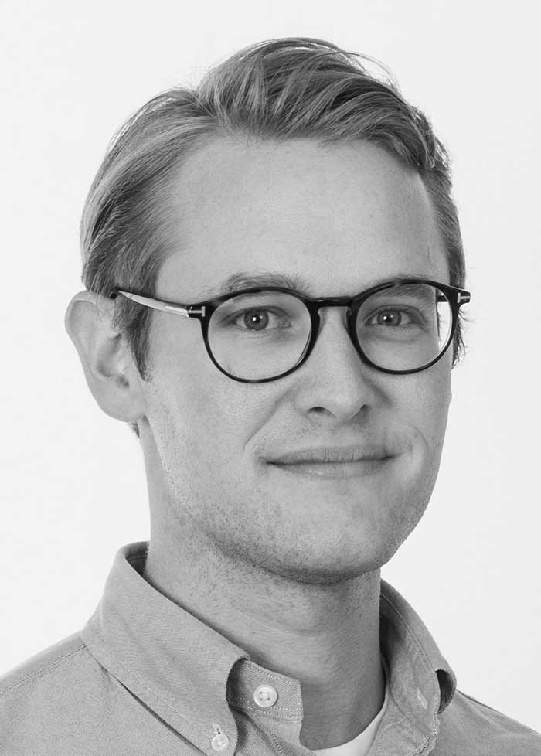

Personell
ProFag
Skramstad, Kontorsjef
Caballero,
Prof. II (20%)
Malthe-Sørenssen,
FI
Mørken,
MI
Tellefsen,
MN/KURT
Haraldsrud,
Univ. Lektor (40%)
Løvold,
Univ. Lektor (50%)
Finansiert over CCSE
Ledergruppe CCSE (20%)
Honours-programmet/FI
Odden,
Post. Doc.
Lockwood,
Prof. II (20%)
Nederbragt,
IBV
Sølna,
MN
Sandve,
IFI
Sveinsson,
Førsteam. (innsteg)
S-ASSESS (NFR, FInnUt)
Sand,
PhD-student
Aiken,
PhD-student
Hjorth-Jensen,
FI
Henriksen,
FI
Winther-Larsen,
PhD-student
Marin,
Sci. Programmer

Slide 4
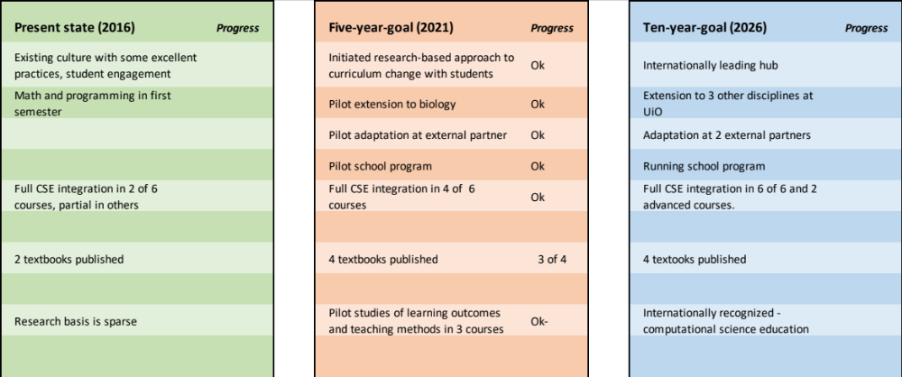
Ten-year progress plan

Slide 5
Developing a discipline-based education research activity
Foundation project:
- Computing and its effect on student understanding, transfer and problem solving abilities
UiO resources:
Education research
Didactic research
Computational literacy:
- Computing and its effect on student problem solving abilities, creativity and disciplinary expression
Assessment project:
- Developing assessment methods, analyzing student results, intervention studies
External funding
Resources
Projects
International partners
Discipline based education research
Connection to international projects (INTPART)
External funding
Pathways project:
- Data science and machine learning to address student assessments, learning and pathways
School project:
- How to teach programming in schools, and how to organize teacher professional development programs
External funding

Slide 6
Integration across the educational timeline
1-13
Bachelor
Master
PhD
Post-grad
Programming in math
Computational skills ladder
Contextual computing
Contextual computing
Contextual computing
Contextual data science
Contextual data science
Contextual data science
Integrated in other subjects
Teacher education and prof devel
Integrated in disciplinary education
Cofund TraCS:
Training in Computational Science
CS MSc program
Programming in context

Slide 7
Dissemination: Playbook
Initialization
Early adaptation
Adaptation
Integration
Presentations and site visits
Demonstrate material
Map research alignment
Finance student taskforces
Identify key personnel
Examples and exercises
Develop faculty competence
Cross-curriculum
Faculty initiatives
Integration of research activity
Part of learning outcomes
Admin & leader support
Develop own material
Educate own faculty
Partner in dissemination
Bioscience@UiO
Physics@UiT
Humanities@UiO
Science@NUDT
Engineering@USN

Slide 8
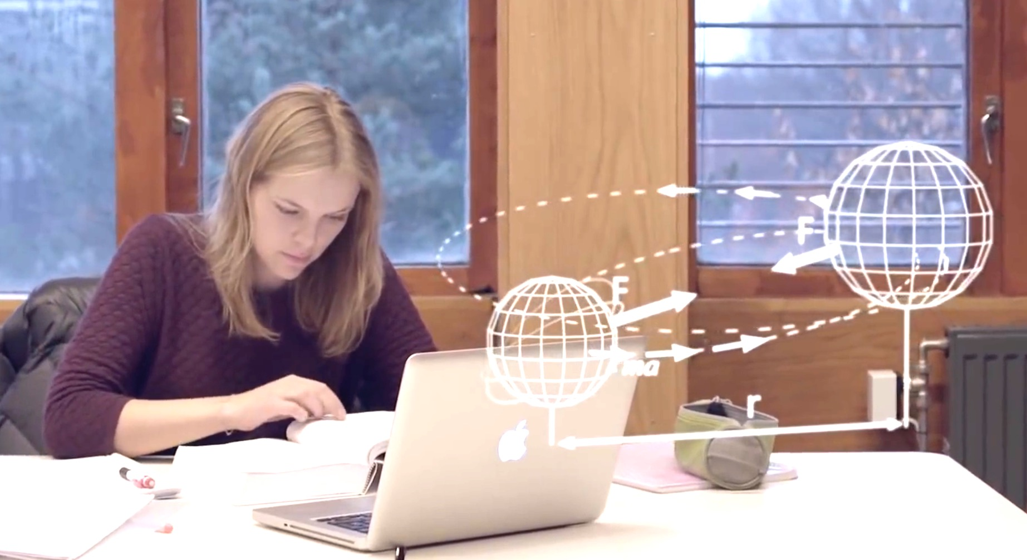
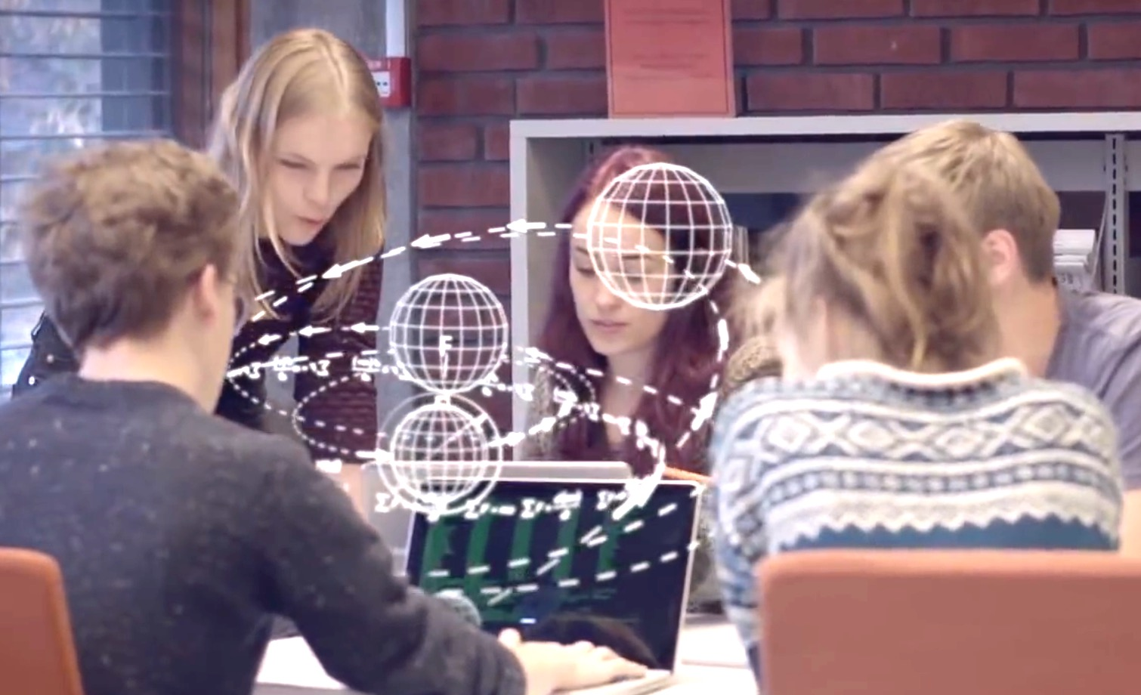
Studentene er våre endringsagenter!

Slide 9
Oppsummering
Invester i utdanningsforskning - knyttet til aktiviteten
  Det er svært vanskelig å måle suksess
Lag en plan for spredning som er tilpasset deres prosjekt
Forny gruppen underveis og trekk flere med i ledelsen

